Slide 1
Contributory Pension Scheme
Members’ Meeting
6 March 2016

Slide 2
Agenda
Chairman’s introductory remarks | Howard Jacobs
University Pension Arrangements
Responsible investment
CUACPS Summary Funding Statement | Sue Curryer
CUACPS overview
CUADCPS (SEI Master Trust) overview | David Snowdon, SEI
Round up and final Q&A | All

Slide 3
University Pension Arrangements - overview
University
Assistant Staff
Cambridge University Assistants’ Contributory Pension Scheme
Cambridge University Assistants’ Defined Contribution Pension Scheme
Academic and Academic Related Staff
Universities Superannuation Scheme
NHS
(clinical staff only)

Slide 4
University Pension Arrangements – joined after 31 December 2012
Hybrid pension arrangement
Cambridge University Assistants’ Contributory Pension Scheme (CUACPS)
Cambridge University Assistants’ Defined Contribution Pension Scheme (CUADCPS)

Slide 5
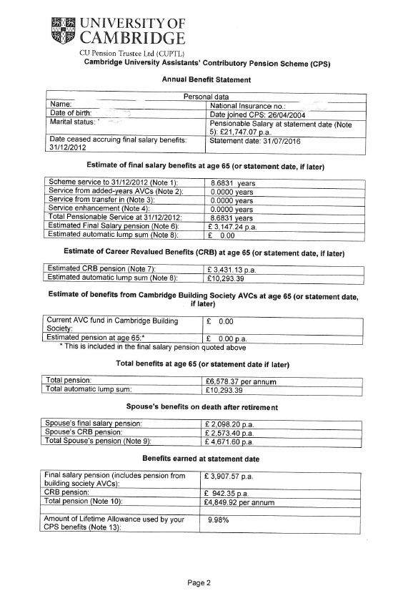
CPS Benefit Statement

Slide 6
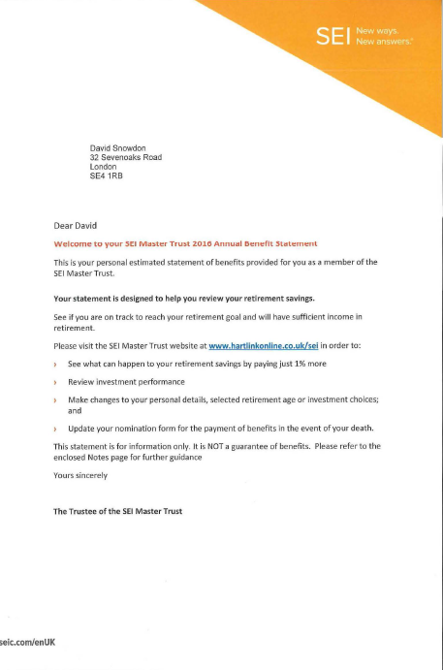
Your DC Master Trust Annual Benefit Statement

Slide 7
Scheme Funding Statement

Slide 8
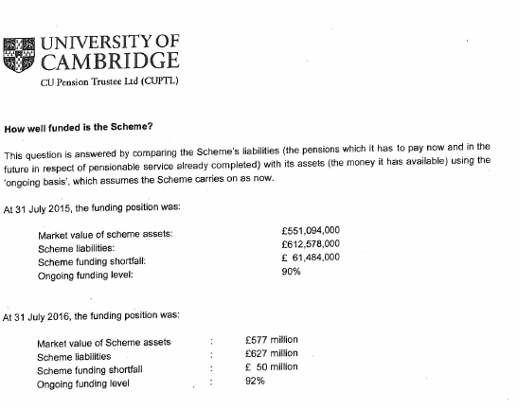
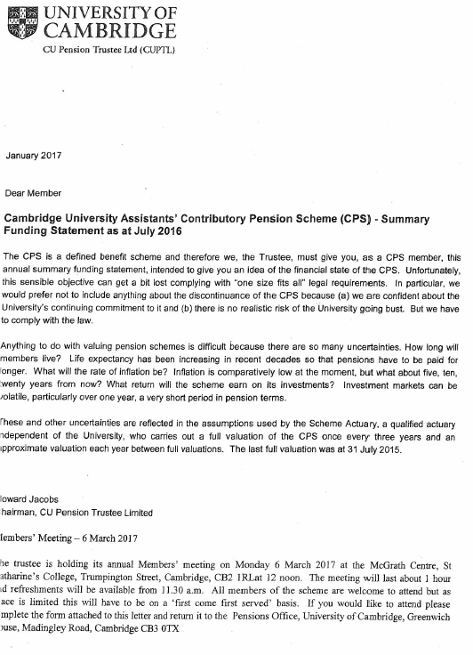
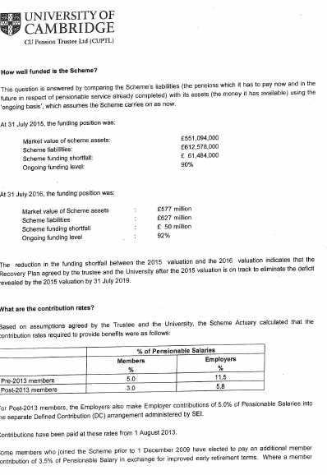
Scheme Funding

Slide 9
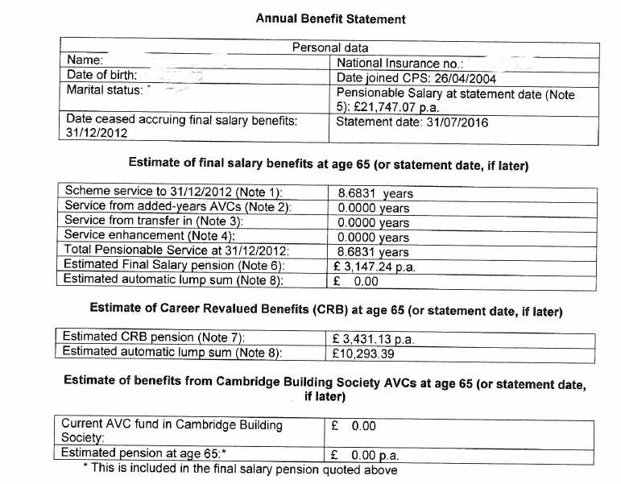
Annual Benefit Statement - Members joined Pre 2013

Slide 10
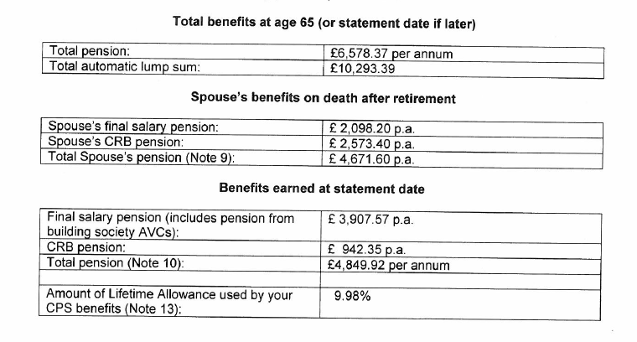
Annual Benefit Statement - Members joined Pre 2013

Slide 11
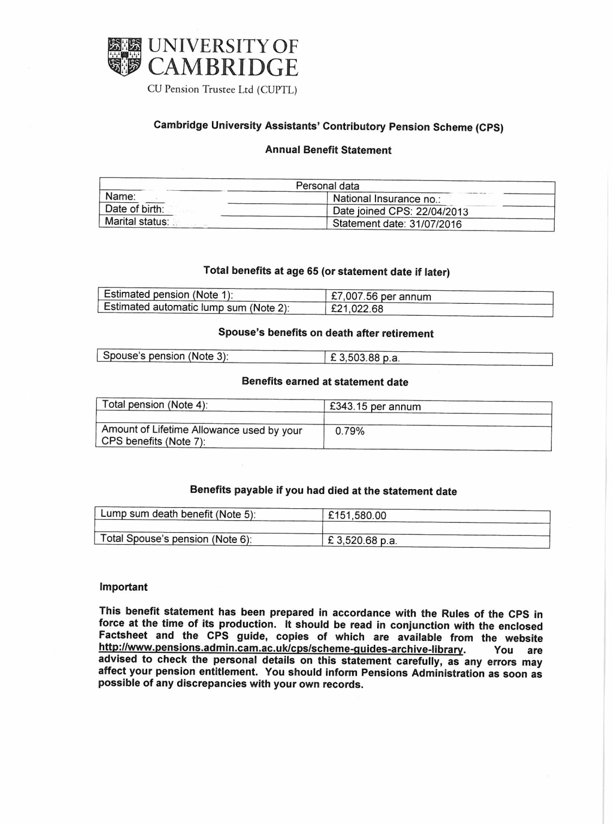
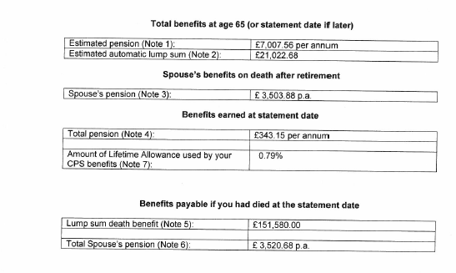
Annual Benefit Statement - Members joined Post 2013

Slide 12
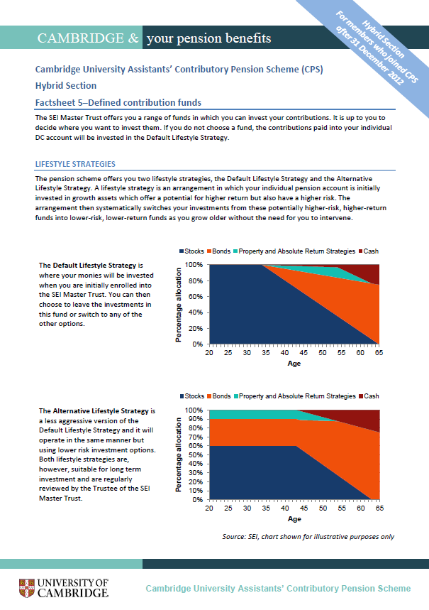
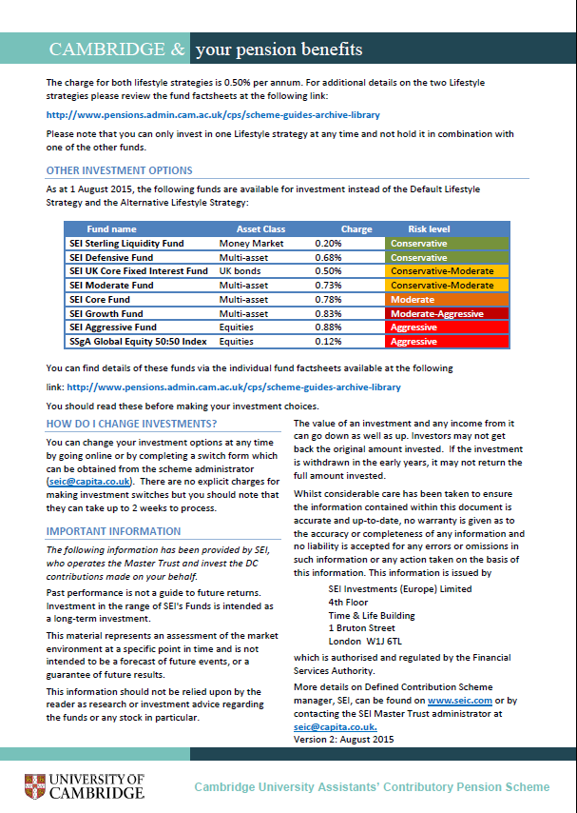
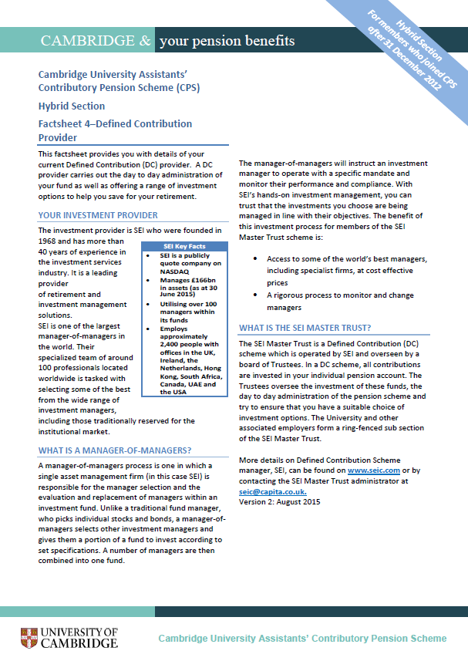
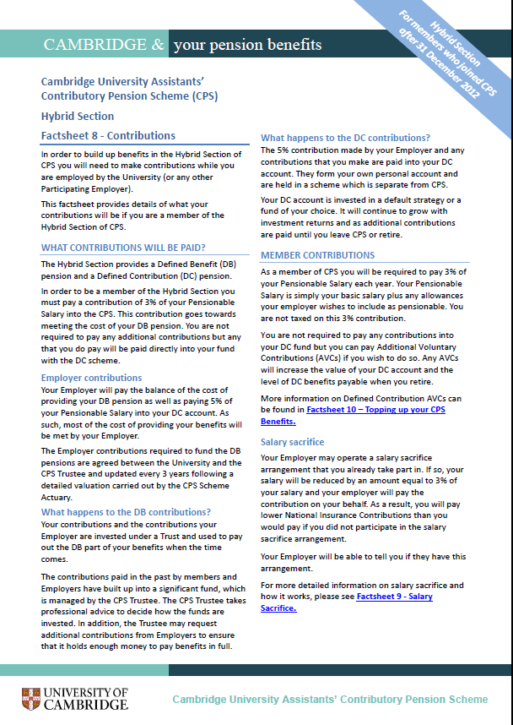
CPS Guides and Factsheets
www.pensions.admin.cam.ac.uk

Slide 13
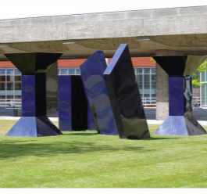
List of detailed factsheets available from the Pensions Office or website
1. Eligibility
2. Retirement benefits
3. Defined contribution basics
4. Defined contribution provider
5. Defined contribution fund factsheets
6. Defined contribution investment guide
7. Defined contribution retirement guide
8. Contributions
9. Salary sacrifice
10. Additional Voluntary Contributions
11. Early retirement
12. Late retirement
13. Pension increases
14. Death benefits
15. Leaving service benefits
16. Ill health benefits
17. Transfers
18. Divorce
19. State benefits
20. Disputes and complaints

Slide 14
Any Questions?

Slide 15
Cambridge University Assistants’ Defined Contribution Pension Scheme - the SEI Master Trust
Members’ Meeting
March 2017

Slide 16
CUA DC Pension Scheme: the SEI Master Trust
Who are SEI?
How does the Master Trust work?
What can be paid in
What can be paid out
Investment options
More information
Questions

Slide 17
Who are SEI?
1968
Founded
300
Investment Experts
25
Participating Employers
Access to over 100 managers
499
Institutional
clients worldwide
£216bn
Assets Under Management*
(2016)
*As at 30 September 2016
(2015)
Notes:
Number of participating employers: 23
Number of members: 15000
Assets : £235m
No Debt.
Taken on 2-3 schemes per year
The Master Trust has been running for 9 years. It is our only DC offering
Master Trust Assurance since 2015, Type 2 in May 2016, approved by tPR

Slide 18
How does the Master Trust work?
While you are working
The University pays into your account…
…and you pay less tax if you save too!
When you retire
You can take up to 25% as a lump sum tax free
The rest can provide you with extra income and/or
be taken as lump sums(s)

Slide 19
Tax relief on your contributions - example
1. Employer contribution
£2,000 | x | 5% (ER) | = | £100 p/m
2. Employee contribution
£2,000 | x | 5% (EE) | = | £100 p/m
Less tax relief at 20% |  |  |  | -£20 p/m
Reduction in your take home pay |  |  | = | £80 p/m
Illustration assumes that member is a basic rate tax payer with a pensionable salary of £24,000 pa

Slide 20
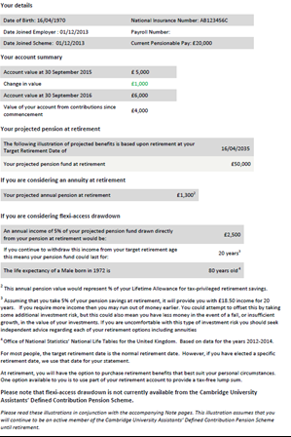
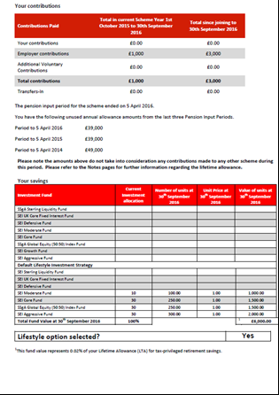
Your DC Master Trust annual benefit statement

Slide 21
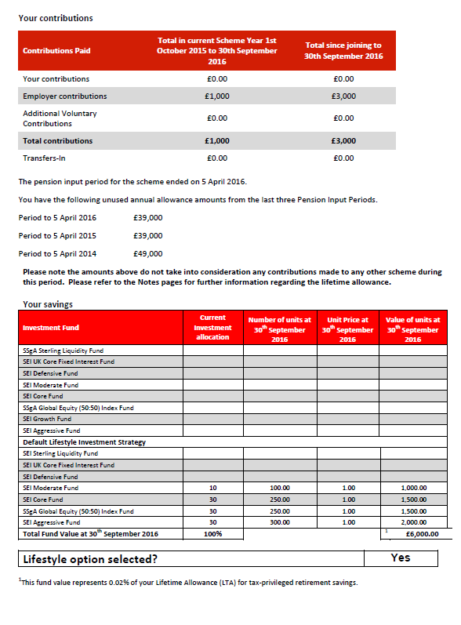
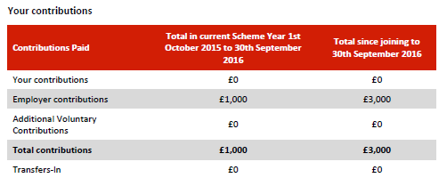
Where do the contributions show?
Your contributions
University contributions
Total paid in since joining

Slide 22
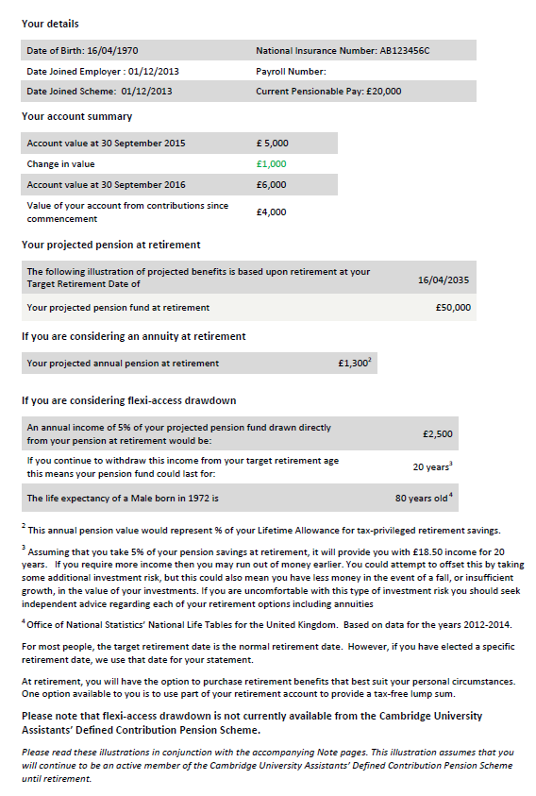
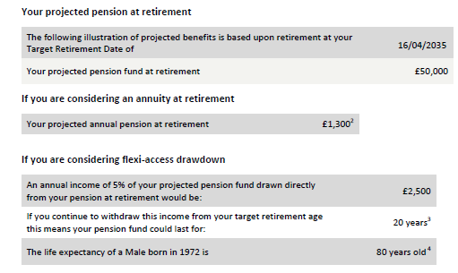
What your benefits could be at your selected retirement age
What your DC Account could be worth at your selected retirement age
Your ‘selected’ retirement age (you can change this at any time)
What you might get at your selected retirement age from an annuity.
5% of your fund taken as an annual income
Average life expectancy for someone born in the same year as you

Slide 23
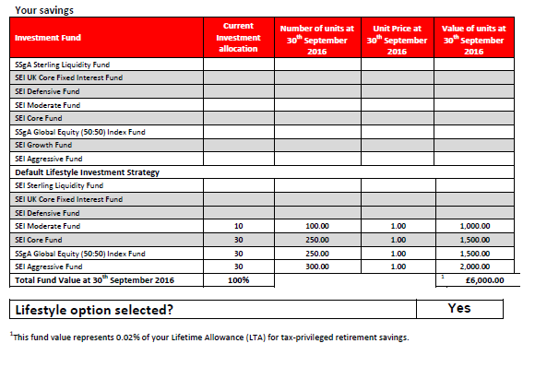
How the contributions are being invested
Fund Names
Value invested in each Fund
Invested in the Default Strategy?

Slide 24
Default Lifestyle Strategy = “Decide on my behalf”
Where the 5% employer contribution is automatically invested when you join
Where 99% of members are invested
Remain in this strategy or switch into other funds at any time
Total investment management charge of 0.50%
Built around selected retirement age (65 as default)
Automatically switches into lower risk funds as you get older
Inform us if you decide to retire early/later

Slide 25
Flexible fund choices = “I want to choose”
Fund name | Asset Class | Total Investment Charge | Risk level
SEI Sterling Liquidity Fund | Money Market | 0.20% | Conservative
SEI Defensive Fund | Multi-asset | 0.68% | Conservative
SEI UK Core Fixed Interest Fund | UK bonds | 0.50% | Conservative-Moderate
SEI Moderate Fund | Multi-asset | 0.73% | Conservative-Moderate
SEI Core Fund | Multi-asset | 0.78% | Moderate
SEI Growth Fund | Multi-asset | 0.83% | Moderate-Aggressive
SEI Aggressive Fund | Equities | 0.88% | Aggressive
SSgA Global Equity 50:50 Index | Equities | 0.12% | Aggressive
Build Your Own Portfolio (You do the work)
SSgA Global Equity 50/50 Index Fund
SEI Global Developed World Equity Fund
SSgA UK Equity Index Fund
SEI UK Equity Fund
SEI Emerging Market Equity Fund
SEI UK Core Fixed Interest
SEI Index Linked Gilts Index Fund
SEI Sterling Liquidity Fund
* SSgA Funds have a bid/offer spread
Notes:
25
8 funds from low to high risk. Standalone Cash and Bond funds mostly used in the run up to retirement as low risk.
5 risk rated strategy funds (Moderate to Aggressive) for you to choose from.
Each one is a multi asset fund investing in a wide range of different asset classes – allocation reviewed on an ongoing basis by the managers and amended (eg if Europe bad place to invest – invest less in Europe!)
Those of you with PPs may think 8 is a short list of funds. To give you a feel for what is going on underneath, the Core fund for example has 66 different fund managers responsible for running parts of the fund (Shares, Bonds, UK, US, Europe etc). If we feel we need to replace any of them of them for any reason we do so immediately.
Range selected with employer to provide the right degree of choice but if you need more then we will review.

Slide 26
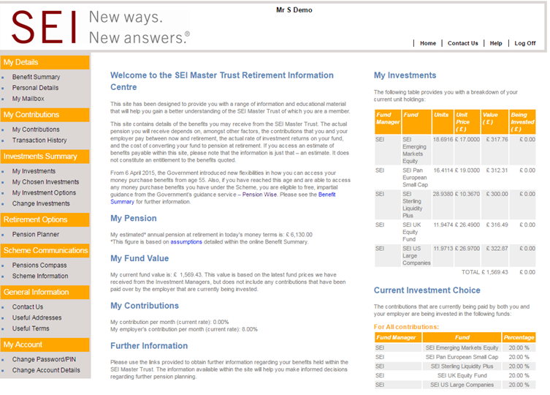
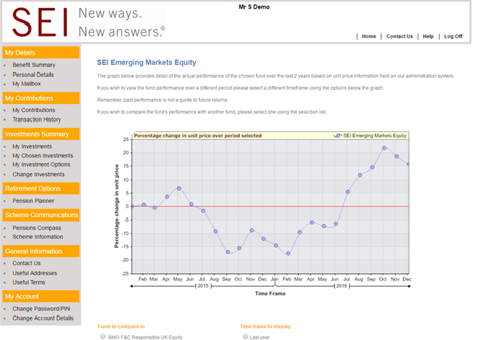
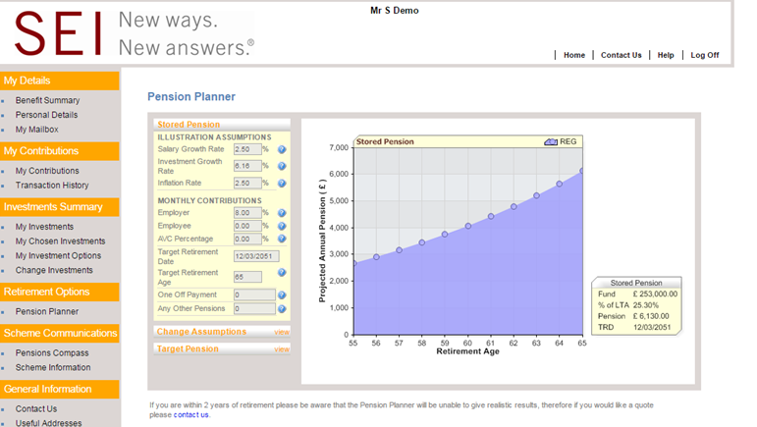
Where can I get more information?
All the information from your statement and a lot more at: hartlinkonline.co.uk/sei
‘What if’ tools, factsheets and newsletters
‘Online valuations, projections and fund switching
SEI Master Trust Member helpdesk: T: 0800 0113540 E: seic@capita.co.uk

Slide 27
Any Questions?

Slide 28
Important information
This information is being provided on behalf of SEI Trustees Limited (the “Trustee”) in your capacity as a member of the SEI Master Trust, an occupational pension scheme (the “Scheme”).
This document is not intended to constitute an offer to buy or sell, or a solicitation of an offer to buy or sell any particular product. Please note, in addition, that any investment products described in this document are only available in relation to your and/or your employer’s contributions to the Scheme – you may not be able to invest in these products directly.
The information in this document is for general information purposes only and does not constitute investment advice. You should read all the investment information and details on the funds before making investment choices. If you are in any doubt about how to invest, you should seek independent advice before making any decisions. Neither this document nor any part of its contents may be reproduced or redistributed without the written consent of the Trustee.
Past performance is not a guarantee of future performance. Investment in the range of the SEI Master Trust’s funds is intended as a long-term investment. The value of an investment and any income from it can go down as well as up. Investors may not get back the original amount invested.
SEI Trustees Limited, 1st floor, Alphabeta, 14-18 Finsbury Square, London EC2A 1BR, United Kingdom +44 (0)203 810 8000.

Slide 29
Appendix
Performance of funds underlying the default strategy

Slide 30
Fund Performance
Asset Allocation Funds Return
 |  |  | 3 Months | 1 Year | 3 Years
SEI GAF Aggressive Fund - GBP Inst |  |  | 6.43% | 24.88% | 12.57%
Aggressive Strategic Portfolio Benchmark |  |  | 5.44% | 24.17% | 11.34%
SEI GAF Core Fund - GBP Inst |  |  | 2.95% | 17.59% | 8.58%
Core Strategic Portfolio Benchmark |  |  | 2.09% | 14.75% | 7.98%
SEI GAF Moderate Fund - GBP Inst |  |  | 1.30% | 14.20% | 7.14%
Moderate Strategic Portfolio Benchmark |  |  | 0.72% | 10.24% | 6.63%
SEI GAF Defensive Fund - GBP Inst |  |  | -0.05% | 5.45% | 2.95%
Defensive Strategic Portfolio Benchmark |  |  | 0.02% | 4.78% | 3.76%
Fixed Income Return
 |  |  | 3 Months | 1 Year | 3 Year
SEI GMF UK Core Fixed Interest GBP Inst |  |  | -3.14% | 10.96% | 8.54%
BofA Merrill Lynch Sterling Broad Market Index (GBP) |  |  | -3.36% | 10.61% | 8.20%
Cash and Equivalents Return
 |  |  | 3 Months | 1 Year | 3 Year
SEI GMF Sterling Liquidity Fund - GBP Inst |  |  | 0.05% | 0.40% | 0.38%
BofA Merrill Lynch British Pound LIBID 1-Month Average (GBP) |  |  | 0.04% | 0.30% | 0.35%
Other Return
 |  |  | 3 Months | 1 Year | 3 Year
State Street Global Equity (50:50) Index Fund |  |  | 4.83% | 21.67% | 9.56%
Blended Benchmark |  |  | 4.85% | 21.67% | 9.53%
Performance shown is gross of fees.
Performance shown to 31 December 2016

Slide 31
Strategic Portfolio Benchmarks
SGAF AGGRESSIVE FUND |  |  | SGAF MODERATE FUND
Until 31/12/2015 | From 1/1/2016 |  | Until 31/12/2015 | From 1/1/2016
38% FTSE All Share Index | 40% FTSE All Share Index |  | 20% FTSE All Share Index | 10% FTSE All Share Index
62% MSCI World Index (Net) | 60% MSCI ACWI IMI |  | 23% MSCI World Index (Net) | 20% MSCI ACWI IMI
 |  |  | 18% BofA ML Sterling Broad Market Index | 25% Barclays Sterling Aggregate Index
SGAF GROWTH FUND |  |  | 30% Barclays Global Aggregate (GBP Hedged) | 45% Barclays Global Treasury 1-3 yrs (GBP Hedged)
Until 31/12/2015 | From 1/1/2016 |  | 9% BofA ML LIBID 3 Month Average Coupon
37% FTSE All Share Index | 30% FTSE All Share Index
45% MSCI World Index (Net) | 55% MSCI ACWI IMI |  | SGAF DEFENSIVE FUND
2% BofA ML Sterling Broad Market Index | 10% Barclays Sterling Aggregate Index |  | Until 31/12/2015 | From 1/1/2016
16% Barclays Global Aggregate (GBP Hedged) | 5% Barclays Global Treasury 1-3 yrs (GBP Hedged) |  | 10% MSCI World Index (Net) | 10% MSCI AC World Index (Net)
 |  |  | 16% BofA ML Sterling Broad Market Index | 15% Barclays Sterling aggregate Index
SGAF CORE FUND |  |  | 24% Barclays Global Aggregate (GBP Hedged) | 50% Barclays Global Treasury 1-3 yrs (GBP Hedged)
Until 31/12/2015 | From 1/1/2016 |  | 50% BofA ML LIBID 3 Month Average Coupon | 25% BofA ML LIBID 3 Month Average Coupon
26% FTSE All Share Index | 15% FTSE All Share Index
26% MSCI World Index (Net) | 35% MSCI ACWI IMI
14% BofA ML Sterling Broad Market Index | 20% Barclays Sterling Aggregate Index
27% Barclays Global Aggregate (GBP Hedged) | 30% Barclays Global Treasury 1-3 yrs (GBP Hedged)
7% BofA ML LIBID 3 Month Average Coupon

Slide 32
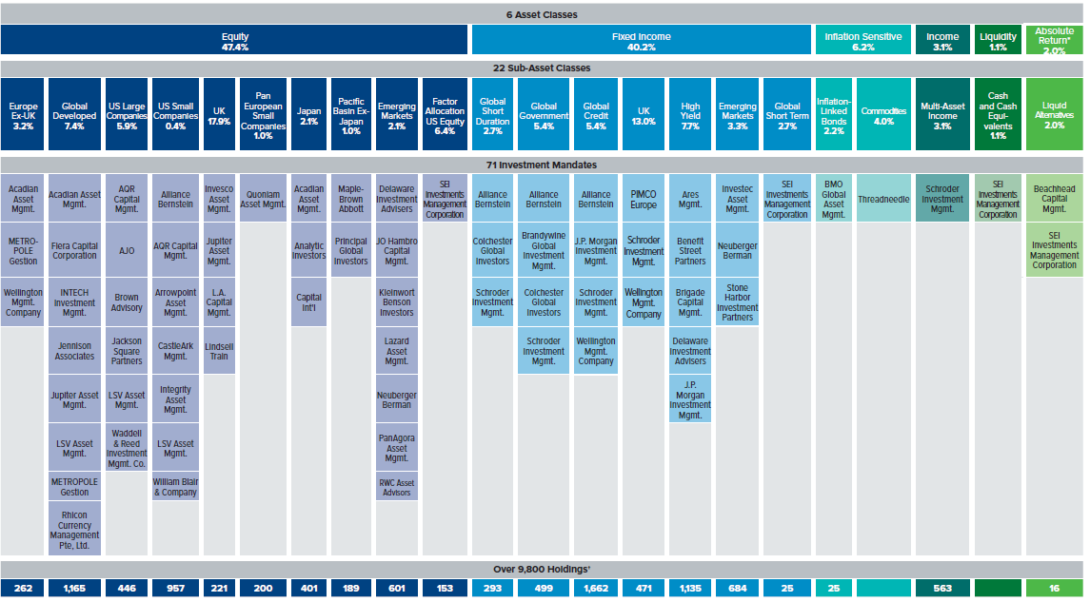
Example: SEI Core Fund
Holdings information as at 30 June 2016
For illustrative purposes only

Slide 33
Responsible Engagement Overlay (REO) SEI’s approach to voting & engagement
ESG overlay with BMO F&C
Equity and corporate bonds
Active Engagement
Robust Proxy Voting
Sustained and constructive dialogue
Rigorous in-house Research
Global capability
Customised approach
Communication with company management
Risk reduction
Better company management
Greater value for Fiduciaries
* Source: F&C
Notes:
NO IMPACT ON THE PORTFOLIO CONSTRUCTION OR INVESTMENT STYLE
Trustees can exert a lot more influence by participating in a powerful and professional engagement overlay manager than by negative screening
Negative screening typically limited to weapons and sometimes child labour, engagement covers a much wider spectrum
Responsible Engagement can be effectively implemented with neutral or positive performance impact
A diverse and specialised ESG competency team is needed with ability to dialogue in multiple languages, maintain deep understanding of industry challenges, local cultures and operating climate
Engagement requires a degree of scale (share representation) to gain the attention of senior management of portfolio holdings

Slide 34
Important information
This information is being provided on behalf of SEI Trustees Limited (the “Trustee”) in your capacity as a member of the SEI Master Trust, an occupational pension scheme (the “Scheme”).
This document is not intended to constitute an offer to buy or sell, or a solicitation of an offer to buy or sell any particular product. Please note, in addition, that any investment products described in this document are only available in relation to your and/or your employer’s contributions to the Scheme – you may not be able to invest in these products directly.
The information in this document is for general information purposes only and does not constitute investment advice. You should read all the investment information and details on the funds before making investment choices. If you are in any doubt about how to invest, you should seek independent advice before making any decisions. Neither this document nor any part of its contents may be reproduced or redistributed without the written consent of the Trustee.
Past performance is not a guarantee of future performance. Investment in the range of the SEI Master Trust’s funds is intended as a long-term investment. The value of an investment and any income from it can go down as well as up. Investors may not get back the original amount invested.
SEI Trustees Limited, 1st floor, Alphabeta, 14-18 Finsbury Square, London EC2A 1BR, United Kingdom +44 (0)203 810 8000.

