Slide 1
Contributory Pension Scheme
Members’ Meeting
18 March 2019

Slide 2
Agenda
Chairman’s introductory remarks Howard Jacobs
University Pension Arrangements
CUACPS – 2018 Actuarial Valuation Robert Sweet, Cartwright
CUADCPS (SEI Master Trust) overview David Snowdon, SEI
Pension Scams Sue Curryer
Financial Wellness project Sam Murphy
Round up and final Q&A All

Slide 3
University Pension Arrangements - Overview
University
Assistant Staff
Cambridge University Assistants’ Contributory Pension Scheme
Cambridge University Assistants’ Defined Contribution Pension Scheme
Academic and Academic Related Staff
Universities Superannuation Scheme
NHS
(clinical staff only)

Slide 4
University Pension Arrangements - Joined after 31 December 2012
Hybrid pension
arrangement
Cambridge University Assistants’ Contributory Pension Scheme (CUACPS)
Cambridge University Assistants’ Defined Contribution Pension Scheme (CUADCPS)

Slide 5
Actuarial Valuation as at 31 July 2018 Introduction
Timeline
Last formal actuarial valuation as at 31 July 2015
Interim actuarial reviews as at 31 July 2016 and 31 July 2017
Next formal actuarial valuation as at 31 July 2018 just being finalised
Purpose of Actuarial Valuation
Compares value of assets held with funding target
Determines contribution rate
- to meet cost of future service benefits
- to eliminate any past service deficit

Slide 6
Actuarial Valuation as at 31 July 2018 Valuation of Assets
ASSET ALLOCATION SINCE 31 JULY 2017 Percentage of Total Assets
 | 31 Jul 2017 % | 30 Sep 2017 % | 31 Dec 2017 % | 31 Mar 2018 % | 31 Jul 2018 % | Market Value as at 31/07/2018 £ | 31 Dec 2018 % | Market Value as at 31/12/2018 £
Equity UK Global ex UK Emerging Markets | 31.4 23.6 9.4 | 31.0 23.7 9.2 | 31.1 23.9 9.5 | 30.0 23.7 9.5 | 31.4 23.6 9.4 | 222,870,363 169,896,682 64,109,886 | 27.0 22.9 9.0 | 177,062,881 150,527,039 59,127,966
Property | 10.0 | 10.0 | 9.9 | 10.3 | 10.0 | 68,585,700 | 10.9 | 71,477,974
Bonds | 18.8 | 18.4 | 17.8 | 19.3 | 18.8 | 129,088,610 | 19.1 | 125,321,542
Hedge Funds | 6.6 | 6.7 | 6.6 | 0.9 | 6.6 | 46,215,548 | 6.9 | 45,237,391
Cash | 0.2 | 1.0 | 1.2 | 6.3 | 0.2 | 4,879,171 | 4.2 | 27,361,000
Total Assets | 100.0 | 100.0 | 100.0 | 100.0 | 100.0 | 705,645,960 | 100.0 | 656,115,793

Slide 7
Actuarial Valuation as at 31 July 2018 Investment Performance
The recent investment performance is shown below, together with the impact of RPI inflation for the years ending 31 July:
Expect to achieve a return of RPI plus 3.4% p.a.
Actual average return over last 5 years is RPI plus 6.2% p.a.
But valuation assumption for future investment return needs to be prudent.
 | 2014 % | 2015 % | 2016 % | 2017 % | 2018 %
Total Return | 11.1 | 5.7 | 4.7 | 13.5 | 6.8
RPI | 2.5 | 1.0 | 1.4 | 2.6 | 3.2
Total Real Return | 8.6 | 4.7 | 3.3 | 10.9 | 3.6

Slide 8
Actuarial Valuation as at 31 July 2018
Assumptions
Main financial assumptions :
Assumed real rate of investment return further reduced to reflect a more cautious view of the future
Two alternative assumptions for Salary increases considered – ‘Higher’ and ‘Lower’
Life expectancy assumptions also updated to reflect recent mortality experience
Changes act to increase value placed on liabilities
 | 2009 % p.a. | 2012 % p.a. | 2015 % p.a. | 2018 % p.a.
Total investment return | 6.60 | 5.95 | 3.10 | 5.15
Price Inflation (RPI) | 3.40 | 2.75 | 3.40 | 3.25
Real investment return | 3.20 | 3.20 | 2.70 | 1.90
Salary increases | 4.90 | 4.25 | 4.90 | 3.75/4.25

Slide 9
Actuarial Valuation as at 31 July 2018
Results
Past Service Position:
At 2015 valuation deficit was £61,484,000 and funding level was 90%
Position has significantly improved since 2015
 | Lower Salary Increase £000’s | Higher Salary Increase £000’s
Value of Scheme Liabilities | 735,573 | 742,670
Value of Scheme Assets | 708,018 | 708,018
Scheme Deficit | 27,555 | 34,652
Funding Level | 96% | 95%

Slide 10
Actuarial Valuation as at 31 July 2018
Contribution Rates
Future service contribution rates:
Employer also pays 5.0% into separate CUADCPS for Post-2013 members
Some Pre-1 December 2009 members pay additional 3.5% for improved early retirement terms
Member contributions are paid by the Employer for those in the Salary Sacrifice Arrangement
 | % of Pensionable Salaries
 | Current Rate | Lower Salary Increase | Higher Salary Increase
Overall contribution rate | 12.0% | 12.1% | 12.2%

Slide 11
Actuarial Valuation as at 31 July 2018
Deficit Funding
Funding Past Service Deficit
Employer paying £14,595,000 p.a. in addition to future service contributions
Projected to eliminate shortfall by 31 December 2019 (Lower Salary Increases) or 31 May 2020 (Higher Salary Increases)
Progress will be monitored by future actuarial reviews

Slide 12
Cambridge University Assistants’ Defined Contribution Pension Scheme Update
David Snowdon - SEI
March 2019
Note: We cannot provide individual financial planning advice

Slide 13
Agenda
How does the pension scheme work?
Where is my money invested?
When can I access my pension?
Why should I keep my information up to date and what’s available to me?
We value your feedback
Questions?
Notes:
Agenda for the group

Slide 14
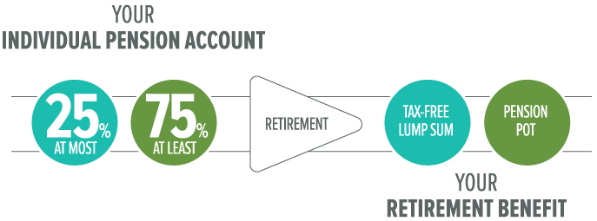
How the pension scheme works
The University contributes 5%
and you can pay in too
The government lets you pay less tax on your contributions
Notes:
Overview of how a pensions scheme works.

Slide 15
Tax relief on your contributions – example of an employee with a pensionable salary of £24,000 pa
1. Employer contribution
£2,000 | x | 5% (ER) | = | £100 p/m
2. Employee contribution
£2,000 | x | 5% (EE) | = | £100 p/m
Less tax relief at 20% |  |  |  | -£20 p/m
Reduction in your take home pay |  |  | = | £80 p/m
Illustration assumes that member is a basic rate tax payer with a pensionable salary of £24,000 pa
Notes:
This is a simple example for someone earning £24,000 a year or £2,000 per month
5% of £2000 - £1000 and this would be the amount that the University would pay into your account
However, if you were to pay in you get tax relief that means if you are a 20% tax payer you actually only see your take home pay reduce by 80% of this (ie £80).
For a higher rate tax payer (C£45k) this comes down to 60%
To show you what your plan is worth and what you might get at retirement we send you an annual benefit statement every year. You should have got one in the last month or so, but if you haven't then I’ll show you the contact detail details at the end and explain how you can ask for a new one.
So, over the next few slides I’d like to just talk you through the annual benefit statement and explain what it’s telling you.

Slide 16
How your money is invested

Slide 17
Default Lifestyle Strategy = “Decide on my behalf”
Where the 5% employer contribution is automatically invested when you join
Where 99% of members are invested
Remain in this strategy or switch into other funds at any time
Total investment management charge of 0.50%
Built around selected retirement age (65 as default)
Automatically switches into lower risk funds as you get older
Inform us if you decide to retire early/later
Notes:
The default strategy uses something called lifestyling which simply means that as you get older and closer to your target retirement age, the level of risk reduces.
Broadly speaking, when investing over the longer term, the expectation is that the higher the risk, the higher the potential growth.
When you are young and have a long time to go until retirement, the fluctuations in the stock markets shouldn’t really matter so much.
However, if there was a big fall in the stockmarket the day before you retired it might mean the amount of income you would receive was much lower or even that you could no longer afford to retire.
So in the years and months leading up to your retirement the default strategy moves your monies out of stocks and shares and increasingly into bonds and cash so that when you retire.
However, for those of you that want to choose your own investments we provide you with a range of ‘risk-rated’ funds to choose from.

Slide 18
Flexible fund choices = “I want to choose”
Fund name | Asset Class | Total Investment Charge | Risk level
SSgA Sterling Liquidity Fund | Money Market | 0.10% | Conservative
SEI Defensive Fund | Multi-asset | 0.68% | Conservative
SEI UK Core Fixed Interest Fund | UK bonds | 0.50% | Conservative-Moderate
SEI Moderate Fund | Multi-asset | 0.73% | Conservative-Moderate
SEI Core Fund | Multi-asset | 0.78% | Moderate
SEI Growth Fund | Multi-asset | 0.83% | Moderate-Aggressive
SEI Aggressive Fund | Equities | 0.88% | Aggressive
SSgA Global Equity 50:50 Index | Equities | 0.12% | Aggressive
Build Your Own Portfolio (You do the work)
SSgA Global Equity 50/50 Index Fund
SEI Global Developed World Equity Fund
SSgA UK Equity Index Fund
SEI UK Equity Fund
SEI Emerging Market Equity Fund
SEI UK Core Fixed Interest
SEI Index Linked Gilts Index Fund
SEI Sterling Liquidity Fund
* SSgA Funds have a bid/offer spread
Notes:
18
8 funds from low to high risk. Standalone Cash and Bond funds mostly used in the run up to retirement as low risk.
5 risk rated strategy funds (Moderate to Aggressive) for you to choose from.
Each one is a multi asset fund investing in a wide range of different asset classes – allocation reviewed on an ongoing basis by the managers and amended (eg if Europe bad place to invest – invest less in Europe!)
Those of you with PPs may think 8 is a short list of funds. To give you a feel for what is going on underneath, the Core fund for example has c60-70 different fund managers responsible for running parts of the fund (Shares, Bonds, UK, US, Europe etc). If we feel we need to replace any of them of them for any reason we do so immediately.
Range selected with employer to provide the right degree of choice but if you need more then we will review.

Slide 19
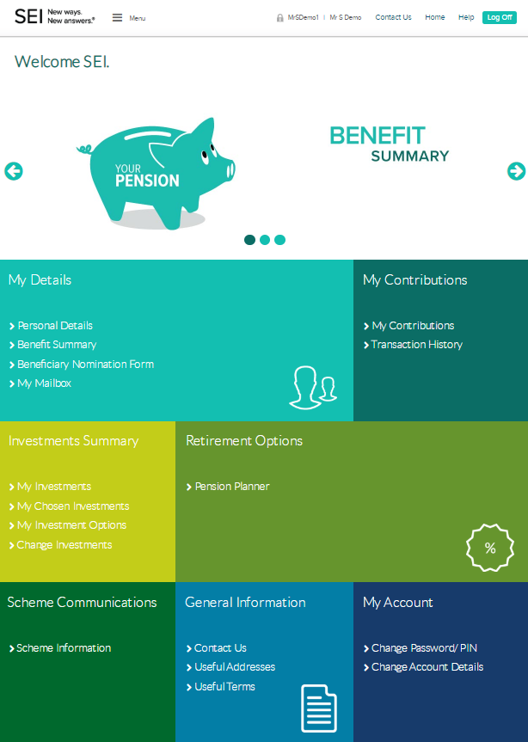
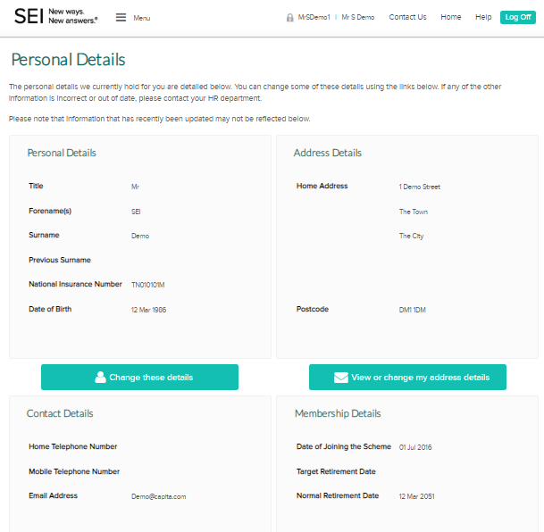
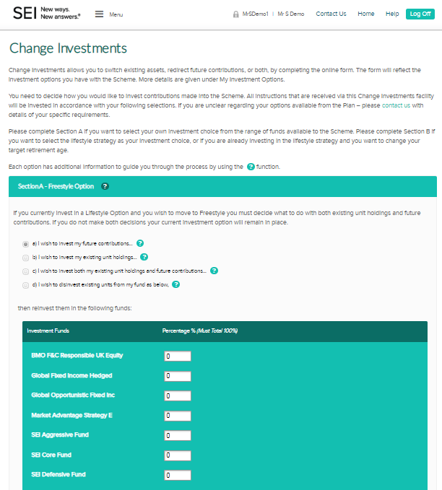
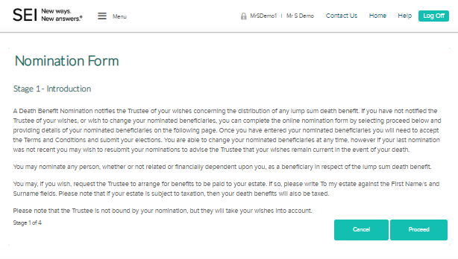
The member website
Change personal details
Nominate beneficiaries
Switch investments
Check value of your account
Project pension benefits
www.hartlinkonline.co.uk/sei
Notes:
Message to confirm items available to existing members of the master trust

Slide 20
Retirement – when can I access my pension?

Slide 21
Flexibility at retirement
Access to the ‘Freedom & Choice’ flexibilities directly from your pension account
From age 55 you can:
Take 25% tax free cash
Draw an income and/or lump sums directly from your account
Buy an annuity (guaranteed income for life)
Notes:
Overview of what is available at retirement

Slide 22
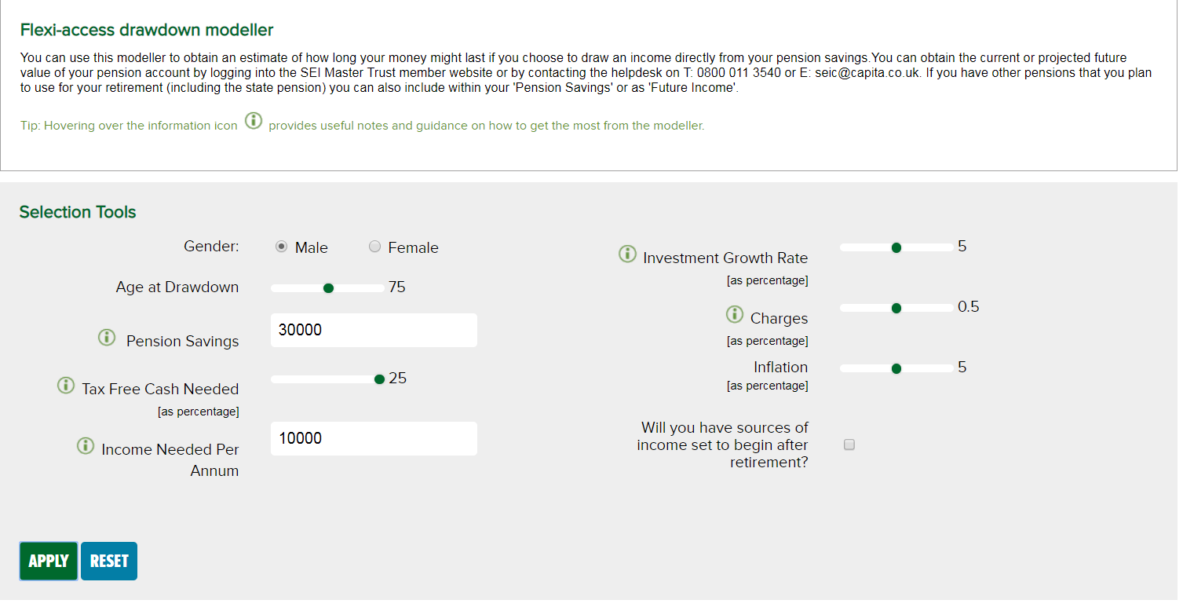
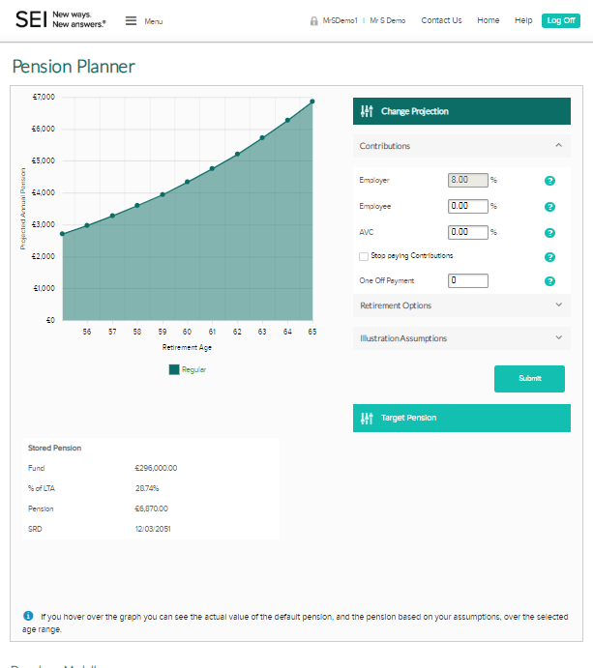
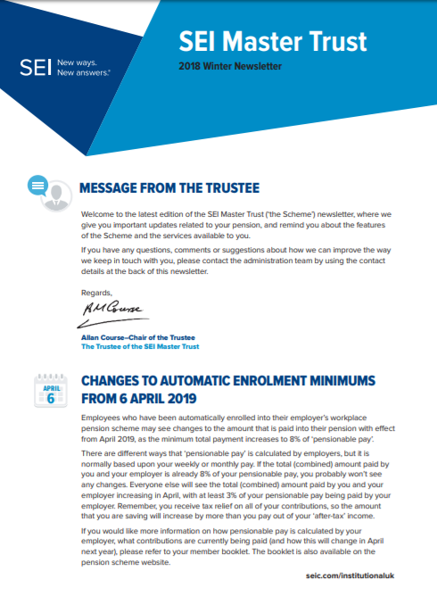
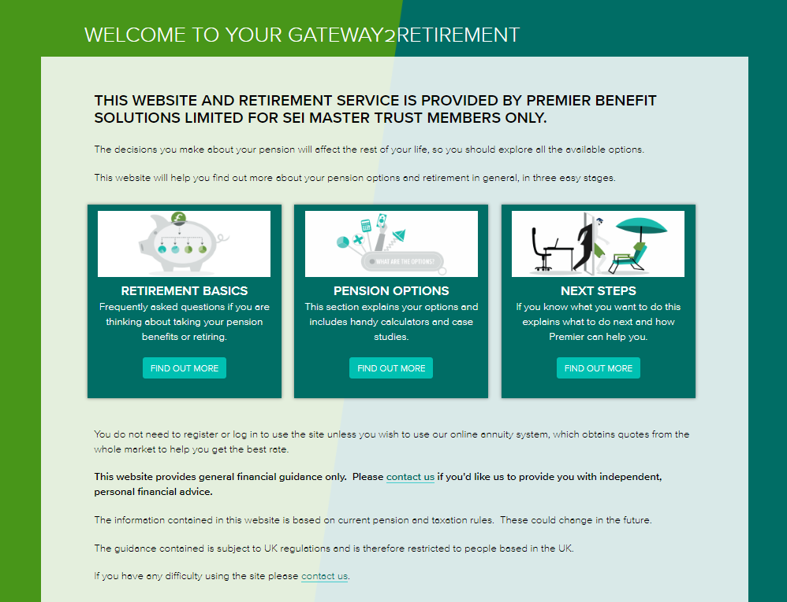
Communications and tools available
Notes:
We will write to explain your options as you approach retirement
Information and guidance on the website
Consider financial advice before taking your benefits
*The remainder will subject to Income Tax

Slide 23
Why should I keep my information up to date?

Slide 24
Why you should keep your information up to date?
Beneficiaries
“What would happen if something happened to me?”
Contact Information
“I have not received any benefit statements”
Pension Updates
“I have not received any updates on my pension from my employer or SEI”
Notes:
Message to highlight the importance of taking control of personal information and why this is important to the members of the Master Trust

Slide 25
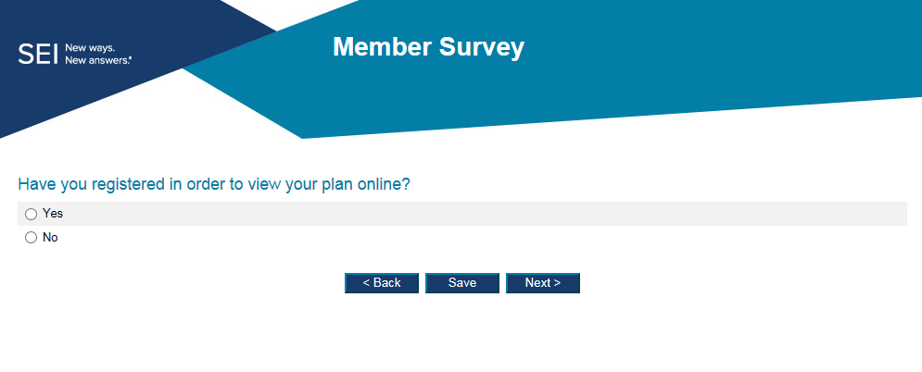
We value your feedback
Your chance to provide feedback
Results will be used to improve what's available to you
Findings will be shared with you once all information captured
Notes:
Highlighting that the member survey will be used to capture feedback to continuously improve what's available to members – The Trustees take the feedback seriously and have a duty to ensure the best interests for the members

Slide 26
Thank you!
?
Notes:
Questions from the group

Slide 28
Important information
This information is being provided on behalf of SEI Trustees Limited (the “Trustee”) in your capacity as a member of the SEI Master Trust, an occupational pension scheme (the “Scheme”).
This document is not intended to constitute an offer to buy or sell, or a solicitation of an offer to buy or sell any particular product. Please note, in addition, that any investment products described in this document are only available in relation to your and/or your employer’s contributions to the Scheme – you may not be able to invest in these products directly.
The information in this document is for general information purposes only and does not constitute investment advice. You should read all the investment information and details on the funds before making investment choices. If you are in any doubt about how to invest, you should seek independent advice before making any decisions. Neither this document nor any part of its contents may be reproduced or redistributed without the written consent of the Trustee.
Past performance is not a guarantee of future performance. Investment in the range of the SEI Master Trust’s funds is intended as a long-term investment. The value of an investment and any income from it can go down as well as up. Investors may not get back the original amount invested.
SEI Trustees Limited, 1st floor, Alphabeta, 14-18 Finsbury Square, London EC2A 1BR, United Kingdom +44 (0)203 810 8000.

Slide 29
Pension Scams
FCA revealed £197 million lost in investment, including pensions scams in 2018
Average loss £29,000, but 2 savers lost £1 million each
Since January 2019 ‘cold calling’ ban, but
only applies to telephone contact
only applies to firms based in UK
online targeting is on increase

Slide 30
Pension Scams – how they work
Contact is normally ‘out of the blue’
May claim to be acting on behalf of the FCA, government or Pension Wise
Offering high returns on investments – overseas property, renewable energy bonds, forestry, storage units
May offer free pension review
May use high pressure sales tactics

Slide 31
Pension Scams – how to protect yourself
If you are contacted out of the blue about a pension opportunity it is likely to be high risk or a scam
The Pensions Office will never share your details with third parties
Professional pensions advice is not free
Don’t be talked into something by a friend, relative or ‘the chap down the pub’ – they may be being scammed
If you are contacted check who you are dealing with –use the FCA register (https://register.fca.org.uk) or ask the Pensions Office
Don’t be rushed or pressured into taking action
Get impartial advice or guidance
contact the Pensions Advisory Service (https://www.pensionsadvisoryservice.org.uk/)
Find out more about getting independent financial advice (https://www.moneyadviceservice.org.uk/en/articles/choosing-a-financial-adviser#how-to-find-a-financial-adviser)

Slide 32
Pension Scams – if you suspect a scam or think you’ve been scammed
Report it
FCA – 0800 111 6768
Action Fraud – 0303 1231113
If you have agreed to transfer you pension and suspect it is a scam contact your pension provider immediately as they may be able to stop the transfer
If you are unsure what to do contact the Pensions Advisory Service (https://www.pensionsadvisoryservice.org.uk)

Slide 33
ANY QUESTIONS
?

Slide 34
CAMbens Benefits
18th March 2019
Notes:
DB
Intro to todays session – we have Myself and Sam who are advisors within the Reward team,
And we are here today to provide you with an overview of employee benefits and how to make the most of the benefits the University offers

Slide 35
What we will cover in this seminar
An overview of CAMbens employee benefits
Where to find information and who you can contact
Your questions
Notes:
So what we aim to cover during this session includes a few themes.
So the main aim is to give you an overview of the benefits on offer to staff at the University (some of the more obvious ones, and few that you may not be aware of
Where you can go to get information
We will also give you a brief intro into a new benefit that is soon to be piloted, Financial Wellbeing
And at the end a chance to ask any questions that you may have. For time purposes though can you hold any questions until the end,

Slide 36
What is covered under CAMbens?
Discounts & Financial
Travel
Relocation & Housing
Wellbeing
Family Friendly
Notes:
So at the University benefits come in all shapes and sizes, and can be group under the following headings.
D&F – shopping and money off – always a good place to start
Travel – and the ways that we can help support staff in however they chose to travel (and not just travel to and from work).
Relocation and housing – very big issue around here.
wellbeing- and the range of services on offer to staff.
Family friendly –
I will now pass over to Bev to take you through some on the benefits

Slide 37
CAMbens – Discounts and Financial
CAMbens Discounts - Access to high street shopping discounts at hundreds of national retailers:
Online and telephone discounts
Cashback on purchases
Discounted vouchers and reloadable cards
Access the scheme via www.cambensdiscounts.co.uk
Save 4%
Save 7%
Save 8%
Save 5%
Save 7.5%
Save up to 10%
Save 5%
Notes:
CAMbens Discounts
The University’s most popular benefit
Enables staff to save money on shopping, both online and Instore
Discounts via instant voucher, discount codes and cashback
Save money on grocery shops, restaurants and fashion or earn cashback on holidays and household bills.
Register on the website, you will be asked to provide basic information including payroll number, email address, date of birth.
Once you have registered remember to do your online shopping through the CAMbens discounts website.
NOTE: AT THE MOMENT, M&S IS 8.5% OFF BUT ONLY FOR TWO MORE DAYS

Slide 38
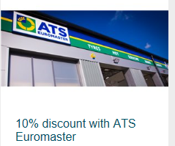
CAMbens – Discounts and Financial
TOTUM (NUS) card - £12 a year for use in high street shops
Payroll Giving – donate to charity from your salary
Local Discounts – Use your University card
Notes:
TOTUM card - NUS discount
As a staff member of the University of Cambridge, you are entitled to purchase a TOTUM card (previously NUS) for £12, for use at thousands of high street, online stores, eateries, subscriptions and various other channels.
Payroll Giving
Payroll Giving is a simple, tax-efficient way for employees to make monthly donations to any UK registered charity directly from their gross pay.
Local Discounts
University supports local retailers and has worked together with many of them to provide employees with special deals and discounts. These include: gyms, punting, local restaurants, clothing and are available by showing your University card in-store.
The shopping discounts section on the CAMbens website includes all of the details and we keep adding to them, so its worth checking back regularly.

Slide 39
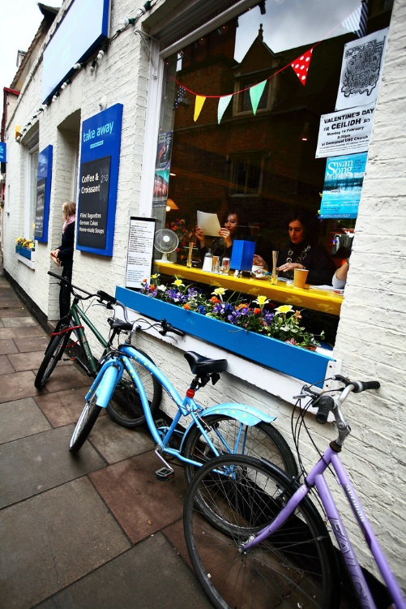
CAMbens - Relocation and Housing
Accommodation service
https://www.accommodation.cam.ac.uk/
Relocation expenses
Eddington community
Newcomers and visiting scholars
Local discounts with removal businesses
Rental deposit loan
Notes:
DB
Accommodation Service
Help all members of Cambridge University to find suitable accommodation.
Relocation expenses
If you are new to the University and relocating to Cambridge on a centrally funded appointment of two years or more.
Eddington Community
at the North West Cambridge Development. Home available to rent and later to buy, enquire through the accommodation service. Newcomers and Visiting Scholars
Volunteers run group who aim to help newly arrived wives, husbands, partners and families of Visiting Scholars and Senior Members of the University to settle down in Cambridge and give them an opportunity to meet local people.
Rental deposit loan
Great attraction and retention tool to help staff in the difficult Cambridge rental market.

Slide 40
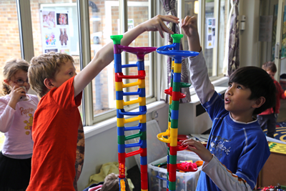
CAMbens – Family Friendly
My family care (elder and childcare)
Flexible working policy
Family leave policies
Childcare support
https://www.childcare.admin.cam.ac.uk
Notes:
So that’s your shopping, travel, housing and moving covered. All that’s left is the benefits that come under the family friendly umbrella.
First of these is My Family Care who deliver family-friendly backup care and will give employees access to a network of child, adult and eldercare across the country at short notice. Introduced by the Equality and Diversity team,
Flexible working policy and the support give to staff who have family commitments
And along side this the University has a range of family policies that go well beyond the legal requirements. Prime example of this being the shared parental leave policy, which gives partners up to 18 weeks at full pay when sharing maternity/ adoption leave with the other parent. And while you cant exactly ask this at an interview, ensuring staff and candidates know what the University offers all forms part the picture to make us an employer of choice.
Childcare support
University nurseries – enable the whole cost of childcare to be salary sacrificed. We do still have a childcare vouchers scheme for those who are already members. The government have now closed this scheme to new entrants and replaced it with tax free childcare. In addition to this there are holiday clubs, and an information service for University parents.
The childcare office also run holiday clubs for older children – they do book up quickly, but staff are charged a lower than commercial rate for a place.

Slide 41
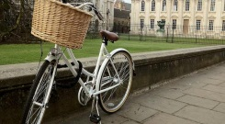
CAMbens - Travel
Cycle to Work Scheme – Salary sacrifice bike scheme which enables savings of up to 42% on a bike. Spreads the cost of the bike over 10 months.
Travel to work loan – Interest free loan to help spread the cost of annual bus or rail season ticket or the purchase of a bike
Train discount - 10% discount rate on the purchase of train season tickets and bulk-buy tickets on certain routes.
Universal bus discount – Discounted rate of £1 per journey when you show your University card.
Zipcar discount - self-service pay-as-you-go cars with a discounted joining fee and free driving credit.
Notes:
Next up, travel – however you get around
Probably our most widest recognized scheme – over 2250 certificates have been issued. See requests on average daily for new certificates.
The scheme enables eligible staff to purchase a new bike and related safety equipment and receive tax and NI savings (so between about 32 and 42% saving on the cost)
Alongside this we operate a travel to work loan (so while no direct saving it does allow for a big upfront costs to be spread out over the year
Those who travel by train can access season ticker discounts on all tickets into Cambridge (even if you coming in from London). There are detailed maps on the routes on the Environment and energy webpages.
The Universal bus £1 ticket allows for travel from Eddington to the addenbrookes site (and it does also apply to some other Go Whippet services from the edge of town).
We also have an arrangement with ZIPcar that provides half price membership and access to vehicles on a hourly and daily rate (there is a car outside the Hauser forum – Hynudoi I30, they also have vans parked elsewhere in the city). – entry level plan is £3 per month and includes 60 miles of driving and fuel. So an alterative to car hire, or short term travel needs.
I will not hand back to Sam to talk through the wellbeing side of staff benefits.

Slide 42
CAMbens - Wellbeing
Wellbeing Benefits to support the 3 pillars
Private Medical Insurance
Local and National gym discounts
Pensions and Savings
Staff Counselling Service
Wellbeing support
Physical Financial Mental
The University’s Wellbeing Agenda
Notes:
Wellbeing can be defined as:
‘Creating an environment that promotes a state of contentment which allows an employee to flourish and achieve their full potential for the benefit of themselves and their organisation’
We consider there to be three pillars of wellbeing, Physical, Financial and Mental.
Physical – PMI at discounted rates, and discounts at local and national gyms. Also have Occupational Health and Westfield Health which offers a scheme where individuals pay a small monthly amount and can then claim back the cost of routine health costs such as dentist or opticians bills.
Mental - Staff Support Services – Staff Counselling, HR contacts, internal mediation service, dignity at work contacts, PPD, E&D, OHS, & wellbeing advocates (new).
Financial – part of this is the pension scheme offered by the University. You also have access to an exclusive CAMbens savings account through the Cambridge Building Society. In addition to these, in March, we are launching a 6-month pilot of a new Financial Wellbeing scheme, provided by Lemonade, specialists in providing financial wellness guidance. We’ll now give you a little more information on the pilot.

Slide 43
Reward suggestion box
Have an idea or suggestion on the way the University rewards its staff through benefits, pay or recognition?
Let us know now or email us at: CAMbens@admin.cam.ac.uk at any time
We’d love to hear any ideas you have on how we can reward people differently, all ideas will be considered by the Reward Team.
Your feedback is invaluable in helping us to shape and deliver reward and benefits that are used by University employees.
Notes:
So, that gives you a summary of the current benefits on offer, and an overview of the new scheme we are launching. We are always keen to hear any ideas for new benefits, and we have a reward suggestion box where you can send any ideas to. Please do get in touch, we’d love to hear from you. This is very important to help us shape and deliver future rewards.

Slide 44
Any questions?
Notes:
Thank you for listening, we’d welcome any questions.
Answer questions on their respective areas.

