Slide 1
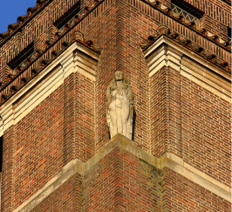
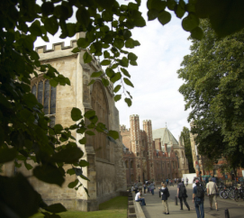
Cambridge University Assistants’ Contributory Pension Scheme (CPS) and Cambridge University Assistants’ Defined Contribution Scheme (CUADCPS)
Key information about the hybrid pension arrangement
A Guide for Members who join on or after 1 January 2013
Version 8: February 2022

Slide 2
About this guide
This guide is prepared on behalf of the University of Cambridge and sets out a summary of the benefits provided under the hybrid pension scheme offered by the University to its employees.
Detailed information
Detailed information including a series of factsheets can be obtained from the Pensions Office website at:
pensions.admin.cam.ac.uk/cps
or by writing to:
Pensions Section
University of Cambridge
Greenwich House
Madingley Road
Cambridge CB3 0TX
Contents
What is the hybrid pension arrangement? 3
What are the main benefits and how much does it cost? 4
Calculating your retirement benefits 7
How does my DC pension work? 8
Where are my DC contributions invested? 9
How are my DC benefits paid when I retire? 10
State benefits 11
Increasing your benefits 12
When can I take my benefits? 13
What happens if I die? 14
Salary sacrifice 15
What happens if I leave the scheme? 16
Auto enrolment 17
Important information and contacts 18
List of detailed factsheets available 21

Slide 3
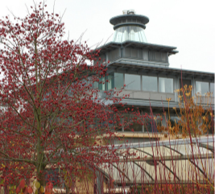
What is the hybrid pension arrangement?
All members of the hybrid pension arrangement will be provided with a DB and DC pension and tax free cash sum at retirement. Benefits will also be paid if you die or if you are unable to work due to ill health.
To protect against inflation, the DB pension and lump sum you earn each year are linked to increases in the Consumer Prices Index.
In addition to the benefits you build up in hybrid pension scheme you will also earn State Pension benefits.
It is called a hybrid scheme because you build up both a defined benefit (DB) pension and a defined contribution (DC) pension. When you retire the DB and DC benefits will be added together.
Please read on to find out more about your hybrid benefits.
It is important to consider saving towards a pension to ensure that you have a good standard of living when you retire. If you are a member of University pension schemes, your employer will make a significant contribution towards your pension, in addition to your own contributions.
When reading this guide please look out for the following symbols:
This means more detailed information is available in the
factsheets provided on the Pension Office website or from the Pensions Section
This means you may need to complete a form to receive the appropriate benefits

Slide 4
What are the main benefits?
As a member of the Hybrid section of the pension scheme you will build up a DEFINED BENEFIT (DB) pension and a DEFINED CONTRIBUTION (DC) fund as follows
+
see retirement benefit factsheet
A DB Pension
You will build up a block of pension equal to 1/150th of the salary you earn each year. You will also build up a cash lump sum equal to 3/150ths of the salary you earn each year.
A DC Fund
Your Employer will pay a contribution equal to 5% of your salary into a retirement fund in your name. Your fund will grow with investment returns and as new contributions are paid each year.
Defined benefit and defined contribution – what’s the difference?
In a defined benefit or DB arrangement, your retirement benefits are normally defined in terms of your salary. This means you know what your benefits will be as a fraction of your salary. The defined benefit part of your benefit is based on your earnings revalued in line with inflation.
In a defined contribution or DC arrangement, your retirement benefits are unknown in advance. Your retirement benefits will depend on a number of factors including the investment returns achieved on your fund and how you choose to take an income at retirement. However, you do know the level of contributions that will be paid into the arrangement by your employer.
The Hybrid section gives you the certainty of a defined benefit pension and lump sum plus a fund to increase your retirement benefits.

Slide 5
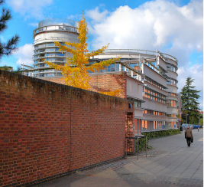
What are the main benefits?
Pension increases
Defined benefit pension - to protect your benefits against inflation, your pension will increase each year both before and after you retire and your cash lump sum will increase each year before retirement.
The annual increases are linked to increases in the Consumer Price Index (CPI) up to a maximum of 5%. If the annual CPI increase is above 5%, the University may provide an additional increase but this is not guaranteed.
Defined contribution pension – when you retire, you can choose how your DC pension increases in payment.
see pension increase factsheet
your dc FUND
In the long term we expect your DC fund to grow with investment returns. However, the value of your fund may reduce in some years if investment returns are negative and this could impact on your DC pension. Please read the DC factsheet carefully for more information on how your DC fund works and the risks involved.
see DC factsheet
Ill health benefits
If you are not able to work due to ill health you may be able to receive a pension and tax free lump sum.
see ill health benefits
factsheet

Slide 6
What are the main benefits?
Contributions
Your basic contribution rate to the DB Section of the Scheme is 3% of Pensionable Pay. You will get tax relief on your contributions, which means that the real cost is lower than 3% for most members. The contribution rate paid by your employer is set by the Scheme Actuary to ensure all benefits can be paid in full.
see contribution factsheet
divorce
If you get divorced your pension benefits will be taken into account in the divorce settlement and it is likely that you will need to take some action with respect to your benefits.
see divorce factsheet
Death benefits
If you die whilst paying into the Scheme a tax free lump sum may be paid and a pension may also be payable. The lump sum payment is made at the discretion of the Trustee to ensure it is paid tax free.
see death benefits
factsheet
Pay more to get more
You can increase your benefits by paying additional contributions into the DC arrangement. Any additional contributions you pay will increase your DC fund and the DC benefits payable when you retire.
see AVC factsheets

Slide 7
Calculating your retirement benefits
As described on page 4 of this guide, your defined benefit pension builds up while you are contributing to the Scheme. Each year you build up a block of pension equal to 1/150th of your salary and a cash sum of 3/150ths of your salary. The pension and cash you earn is increased at 1 August every year in line with changes in the Consumer Prices Index (CPI), subject to limits.
In addition to your defined benefits described above, you will also build up a defined contribution fund based on annual contributions from your employer of 5% of your salary.
The following simplified example, which is based on a member with exactly 5 years of service under the Hybrid section, shows you how it works. We have assumed that CPI increases by 3% per annum. We have not allowed for any investment returns on the DC fund to keep the example easy to understand.
In this example, the member has built up five ‘blocks’ of pension which total £926. The member has also built up five blocks of cash totalling £2,779.
In addition, the member has built up DC fund of £6,550 before allowance for any investment returns. The DC fund will be used to provide an additional pension and lump sum at retirement.
see retirement benefits factsheet
Year | Salary in year | Pension earned in year | Cash earned in year | Cont. to DC fund | Pension revalued to end of year 5 | Cash revalued to end of yr 5
1 | £25,000 | £167 | £500 | £1,250 | £188 | £564
2 | £25,500 | £170 | £510 | £1,275 | £186 | £558
3 | £26,000 | £173 | £520 | £1,300 | £184 | £552
4 | £27,000 | £180 | £540 | £1,350 | £185 | £555
5 | £27,500 | £183 | £550 | £1,375 | £183 | £550
Total DC fund and annual pension at end of yr 5 |  |  |  | £6,550 | £926 | £2,779

Slide 8
How does my DC pension work?
your own pension account
Each month, your employer pays 5% of your salary into a pension account in your name.
You don’t have to pay anything into your DC account but you can pay additional contributions if you wish to.
Your pension account will be managed by SEI, a specialist investment firm.
see DC provider factsheet
what happens to my pension account?
Your account will grow as contributions are paid in and with investment returns. When you retire you can use some of your account to provide a cash sum and use the rest to provide you with a taxable income, either via an annuity or by withdrawing money directly from your account. The diagram below shows you how a DC pension works.
IN
YOUR INDIVIDUAL PENSION ACCOUNT
OUT
TAX-FREE CASH SUM
+
RETIREMENT INCOME
CONTRIBUTIONS
INVESTMENT GROWTH
+

Slide 9
Where are my DC contributions invested?
WHAT ARE MY CHOICES?
For members who want to choose a particular fund there is a choice of funds available to suit different attitudes to risk.
If you don’t make a choice your contributions will be invested in the default lifestyle strategy.
Full details of the funds, including charges are provided in the fund factsheets.
see fund factsheets
do I Need to manage my pension account?
You should monitor your pension account to ensure that your savings remain on target. We will provide you with annual statements which show the value of your account and your expected DC pension at retirement.
If you invest in the default strategy or the alternative lifestyle strategy, your investments will be switched automatically from higher risk assets into low risk assets as you approach retirement
If you invest in any of the other funds you should review your investments at least once a year.
If you wish to make a change to your investments please contact the Pensions Section (see page 2)
For more information on investments, please refer to the investment guide.
see investment guide
what is lifestyling?
If you invest in the default strategy or the alternative lifestyle strategy, your individual pension account is automatically switched from higher risk, higher return funds into lower risk, lower return funds as you approach retirement. This is known as lifestyling and the aim is to provide growth at younger ages and protection as you approach retirement.

Slide 10
How are my DC benefits paid when I retire?
At retirement
You will have several options when you retire. The choice is yours, but remember the money you have accumulated may have to last a lifetime - not just yours, but anyone else dependent upon you. Shortly before you retire you will be sent details of your pension account and the options you have. It may be appropriate to take independent advice before you make a decision.
Your options
You can currently take up to 25% of your account as a tax free lump sum. The remaining 75% will be taxable, but you can choose to use it to buy an annuity (guaranteed income for life); draw an income directly from your pension account; or withdraw it all in one go or as a series of lump sums
Please also see the annuity options factsheet
YOUR INDIVIDUAL PENSION ACCOUNT
YOUR RETIREMENT BENEFIT
25%
AT MOST
Tax Free
75%
AT LEAST
Taxable
TAX FREE LUMP SUM
PENSION POT
FULL/PARTIAL WITHDRAWAL
RETIREMENT
FLEXI-ACCESS DRAWDOWN
ANNUITY

Slide 11
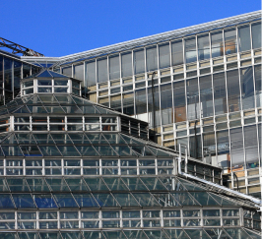
State benefits
While you are a member of the University pension scheme you will build up State pension benefits as well as your Scheme benefits.
see State benefits factsheet
State Second Pension (S2P)
While you are a member of the scheme up until 5 April 2016 you will build up State pension benefits under S2P. These benefits will come into payment at your State Pension Age.
You will also continue to build up your entitlement to the Basic State Pension.
Single State Pension
With effect from April 2016 a new Single Tier Pension (STP) replaced the Basic State Pension (BSP) and Second State Pension (SSP) for anyone who reaches State Pension Age (SPA) after 6 April 2016. If you reached SPA before 6 April 2016 you will continue to be entitled to state pension benefits under the pre 2016 arrangements.

Slide 12
Increasing your benefits
You may want to consider paying extra contributions to increase your benefits. You will get tax relief on any extra contributions you pay.
You can also pay extra contributions to other pension arrangements. You may wish to take independent financial advice before you increase your contributions.
TOPPING UP YOUR DC FUND
The scheme includes a facility for members to pay additional contributions into their DC accounts in order to top up their pension benefits.
This facility is open to new contributions from all scheme members.
see AVC factsheet
complete AVC application form
What other benefits do you have?
In addition to your scheme benefits you also have State pension benefits and you may have pension benefit in other arrangements , for example with previous employers.
You should check that your total pension from all sources is on target to provide you with a good level of income when you retire.

Slide 13
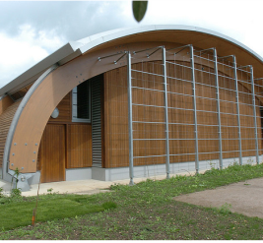
When can I take my benefits?
Normal Pension Age in the scheme is 65. However, it may be possible to take your benefits before or after age 65.
Late retirement
You can choose to take your benefits after age 65 and continue to pay into the scheme to build up further benefits. If you do, your DB retirement pension and lump sum will include the extra blocks built up after age 65 as well as those built up before age 65. Your employer will also continue to contribute to your DC fund. Please note that if you withdraw any taxable benefits from your DC fund and either you and/or your employer continue to make payments, these contributions could be subject to the Money Purchase Annual Allowance of £4,000.
see late retirement factsheet
Early retirement
Defined benefit pension - If you take your DB benefits before age 65 (excluding retirement due to ill health) any pension you receive will be reduced because the pension will be paid for a longer period of time. Currently, the early retirement reduction is approximately 5% for each year you take your benefits before age 65.
Defined contribution pension – If you take your DC benefits before age 65 it is likely that your DC fund will be lower than it would be at 65. It is also likely that the pension you can buy with your DC fund will be lower because it will be paid over a longer period. If you draw an income directly from the fund, this could reduce your DC fund to zero whilst you are still in retirement.
see early retirement factsheet

Slide 14
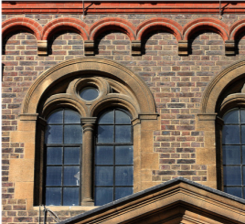
What happens if I die?
Death in service
If you die in service a lump sum of five times your salary is payable from the DB section free of tax at the discretion of the CU Pension Trustee Limited (the Trustee).
In addition, if you are married or have a civil partner, your spouse or partner is entitled to receive a pension, at the discretion of the Trustee, as described below.
A defined benefit pension equal to 50% of the defined benefit pension you would have received at age 65
plus
The benefits that can be purchased with (or the value of) your accumulated defined contribution fund.
A child allowance may also be payable if you have dependent children.
complete death benefits form
see death benefits factsheet
Death after retirement
If you die after retirement your spouse or partner is entitled to receive a pension as described below.
A defined benefit pension equal to 50% of your defined benefit pension at the date of your death
plus
Any spouse’s pension that you purchased with your defined contribution fund when you retired.
For members who joined the scheme 31 December 2022 or earlier a funeral grant will also be payable from the DB section. The net funeral grant after HMRC charges ranges from £1,125 to £1,500.
see death benefits factsheet

Slide 15
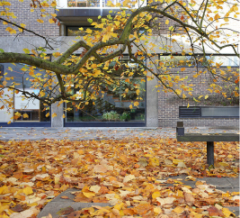
Salary sacrifice
SALARY SACRIFICE
The University and some other employers operate a salary sacrifice arrangement which is outlined in your contract of employment. Unless you asked not to join it, you will take part in this arrangement, which means your salary is reduced but the University pays your contributions to the pension scheme.
WHAT IS SALARY SACRIFICE?
Under the salary sacrifice scheme your salary is reduced by an amount equal to your contribution to the Scheme (i.e. 3%). Your employer then pays the contribution on your behalf. As a result, members can make savings on their National Insurance Contributions which in turn leads to an increase in take home pay.
The salary sacrifice scheme does not have any effect on the amount of your Scheme pension benefits. However, if you leave the Scheme with less than 2 years’ service you would not be able to take a refund of any contributions made through the salary sacrifice arrangement (see also page 16).
see salary sacrifice factsheet
National Insurance
Members who use the salary sacrifice scheme may make additional NI savings which reduces the net cost of the Scheme for those members.

Slide 16
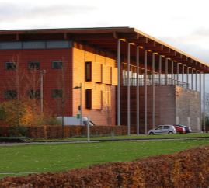
What happens if I leave the Scheme?
If you leave the Scheme either because you have left employment or because you opt out of the Scheme you have a number of choices with respect to your benefits.
see leaving service factsheet
1. Deferred benefits
If you have completed at least two years’ service, you can leave your pension, lump sum from the DB section in the Scheme. Your defined benefit pension and lump sum will continue to increase in line with CPI up to a maximum of 5% each year. Your DC fund will continue to benefit from investment returns. No further contributions will be paid by your employer.
2. Transfer
You can transfer your benefits to another approved pension arrangement. If you are considering a transfer it is important that you take independent financial advice.
The following websites may be useful if you need independent advice: unbiased.co.uk findanadviser.org
3. Refund of contributions
If you have less than two years’ service you may be able to obtain a refund of your contributions to the DB section only.
Please note that you will not be entitled to a refund of contributions for any period during which you participated in your employer’s salary sacrifice arrangement.
see salary sacrifice factsheet

Slide 17
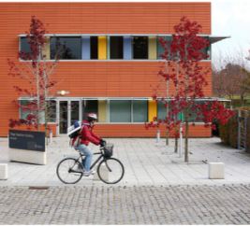
Auto enrolment
Employers must provide a pension arrangement for all eligible employees that meets the Government’s auto enrolment requirements.
What is auto enrolment?
Every employer in the UK must automatically enrol the vast majority of their employees into a suitable pension arrangement. For a pension arrangement to meet the Government’s auto enrolment requirements a number of criteria must be met including employer and employee contribution levels, regulation of the scheme and how benefits accrue to members.
There is also an obligation, on a set date every three years, for employers to assess employees who have previously opted out of the scheme and re-enrol these employees if certain criteria are met.
The University’s pensionn scheme meets or exceeds these requirements and is therefore a “qualifying” scheme. As a member of the scheme you don’t need to do anything about auto enrolment.

Slide 18
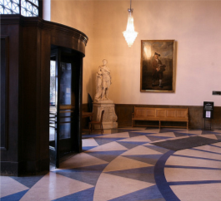
Important information and contacts
Scheme documents
Copies of Scheme reports, the Scheme Rules and other documents are available on the University’s pensions website at: pensions.admin.cam.ac.uk/cps
Scheme complaints (DB section)
We have a formal procedure for dealing with member disputes and complaints which can be accessed using the following link: pensions.admin.cam.ac.uk/cps
In the first instance, if you have a problem or complaint relating to the Scheme, please write to the Head of Pensions Administration
at the address given on page 2 of this guide.
Scheme Rules (DB Section)
This guide provides a summary of your benefits. However, your legal rights are governed by the Trust Deed and Rules of CPS. If there are any differences between the Scheme Rules and this guide, the Rules will override the guide. A copy of the rules can be found using the following link: pensions.admin.cam.ac.uk/cps

Slide 19
Important information and contacts
Scheme queries
If you have any questions relating to your benefits you can contact the Pensions Section using the email address below:
pensionsonline@admin.cam.ac.uk
Investment queries
If you have any questions regarding your Defined Contribution Fund and where your fund is invested you can contact the SEI Master Trust Administration Team. Their address is:
SEI Master Trust Administration Team
Hartshead House
2 Cutlers Gate
Sheffield
S4 7TL
Tel: 0800 0113540
Email: SEIC@capita.co.uk
Please quote your National Insurance number when contacting the Administration Team.
Moneyhelper
This service may assist members and beneficiaries with any unresolved pension queries. Its address is:
Moneyhelper
120 Holborn
London, EC1N 2DT
moneyhelper.org.uk

Slide 20
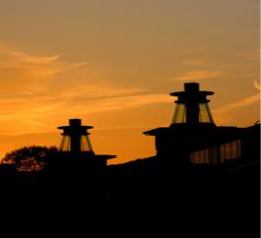
Important information and contacts
The Pensions Regulator
The Regulator is the regulatory body responsible for enforcing the law on occupational pension schemes. Its address is:
The Pensions Regulator
Telecom House
125-135 Preston Road
Brighton, BN1 6AF
Tel: 0845 600 0707 thepensionsregulator.gov.uk
The Pensions Ombudsman
The Ombudsman may investigate any complaints or disputes of fact or law with respect to an occupational pension scheme. Its address is:
The Pensions Ombudsman
10 South Colonade
London, E14 4PU
Tel: 0207 630 2200 pensions-ombudsman.org.uk
Pension Tracing Service
The Tracing Service is a central register to help people trace details of pension schemes they may have lost contact with. Its address is:
The Pension Service 9
Mail Handling Site A
Woverhampton
WV98 1LU
Tel: 0345 6200531

Slide 21
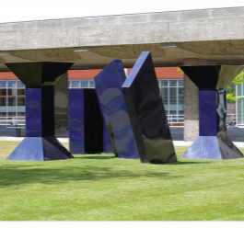
List of detailed factsheets available from the Pensions Office or website
1. Eligibility
2. Retirement benefits
3. Defined contribution basics
4. Defined contribution provider
5. Defined contribution fund factsheets
6. Defined contribution investment guide
7. Defined contribution retirement guide
8. Contributions
9. Salary sacrifice
10. Additional Voluntary Contributions
11. Early retirement
12. Late retirement
13. Pension increases
14. Death benefits
15. Leaving service benefits
16. Ill health benefits
17. Transfers
18. Divorce
19. State benefits
20. Disputes and complaints
21. Flexible Retirement
22. Absence

