Slide 1
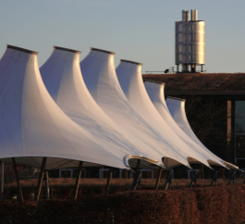
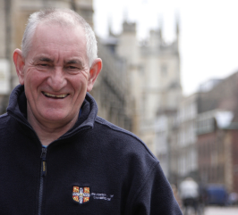
Cambridge University Assistants’
Contributory Pension Scheme (CUACPS)
Career Revalued Benefits (CRB) Section
Key information
A Guide for Members who joined before 1 January 2013
Version 8: February 2022

Slide 2
About this guide
This guide is prepared on behalf of the trustee of the CUACPS and sets out a summary of the benefits provided under the CRB section of the Cambridge University Assistants’ Contributory Pension Scheme (‘CUACPS’).
Detailed information
Detailed information including a series of factsheets can be obtained from the Pensions Office website at:
pensions.admin.cam.ac.uk/cps
or by writing to:
Pensions Section
University of Cambridge
Greenwich House
Madingley Road
Cambridge CB3 0TX
Contents
What is the CRB section? 3
What are the main benefits and how much does it cost? 4
Calculating your retirement benefits 7
State benefits 8
Increasing your benefits 9
When can I take my benefits 10
What happens if I die? 11
Salary sacrifice 12
What happens if I leave the scheme? 13
Auto enrolment 14
Important information and contacts 15
List of detailed factsheets available 17

Slide 3
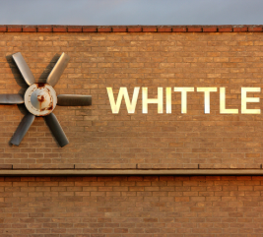


The University has two pension arrangements for support staff, the Cambridge University Assistants Contributory Pension Schemee (CUACPS) and the Cambridge University Assistants Defined Contribution Pension Scheme (CUADCPS). If you joined CUACPS before 1 January 2013 you will be a member of the CRB section of the scheme for service after 31 December 2012
All members of the CUACPS CRB section will be provided with a pension and tax free cash sum at retirement. Benefits will also be paid if you die or if you are unable to work due to ill health.
In addition to the benefits you build up in CUACPS you will also earn State pension benefits.
It is important to save towards a pension to ensure that you have a good standard of living when you retire. As a member of CUACPS , your employer will also make a significant contribution towards your pension.
The final salary benefits you earned before 2013 are protected and will continue to be linked to your salary while you continue to contribute to the scheme. The information in this guide relates only to your CRB benefits.
When reading this guide please look out for the following symbols:
This means more detailed information is available in the
factsheets provided on the Pensions Office website or from the Pensions Section
This means you may need to complete a form to receive the appropriate benefits

Slide 4

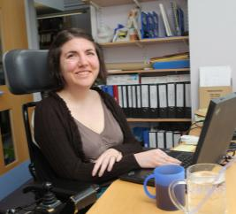
What are the main benefits?
A PENSION AND A TAX FREE LUMP SUM
Starting from 1 January 2013, you will build up a block of pension equal to 1/100th* of the salary you earn each year. You will also build up a cash lump sum equal to 3/100ths* of the salary you earn each year. The blocks of pension and cash that you build up are revalued each year so that your benefits are protected against inflation.
Please see page 7 ‘calculating your retirement benefits’ for more detail.
* the pension and cash accrual rates will be increased to 1/95th and 3/95ths respectively between 1 January 2013 and 31 December 2017.
see retirement benefit factsheet
BENEFITS EARNED BEFORE 2013
If you joined CUACPS before 1 December 2009 you have already built up a pension of 1/60th of your final salary for each year of service before 2013. This pension will continue to be linked to your salary while you contribute to CUACPS. The following link provides details of your final salary benefits:
https://www.pensions.admin.cam.ac.uk/cps/cps-crb-section
If you joined CUACPS on or after 1 December 2009 you have already built up a pension of 1/80th of your final salary and a cash sum of 3/80ths of your final salary for each year of service up to 2013. Both the pension and cash sum will continue to be linked to your salary while you contribute to CPS. The following link provides details of your final salary benefits:
pensions.admin.cam.ac.uk/cps/cps-crb-section

Slide 5
What are the main benefits?
Pension increases
To protect your benefits against inflation, your pension will increase each year both before and after you retire and your cash lump sum will increase each year before retirement.
The annual increases are linked to increases in the Retail Price Index (RPI) up to a maximum of 5%. If the annual RPI increase is above 5%, the University may provide an additional increase but this is not guaranteed.
see pension increase factsheet
Death benefits
If you die whilst paying into the Scheme a tax free lump sum may be paid and a pension may also be payable. The lump sum payment is made at the discretion of the CPS Trustee to ensure it is paid tax free.
see death benefits
factsheet
Ill health benefits
If you are not able to work due to ill health you may be able to receive a pension and tax free lump sum.
see ill health benefits
factsheet

Slide 6
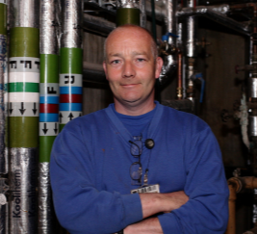
What are the main benefits?
Contributions
Your contribution rate to the Scheme is 5% of Pensionable Pay. You will get tax relief on your contributions, which means that the real cost is lower than 5% for most members. The contribution rate paid by your employer is set by the Scheme Actuary to ensure all benefits can be paid in full.
see contribution factsheet
divorce
If you get divorced your pension benefits will be taken into account in the divorce settlement and it is likely that you will need to take some action with respect to your benefits.
see divorce factsheet
Early retirement
If you joined the Scheme before December 2009 you can take your benefits from age 63 without any reduction.
see early retirement
factsheet
Pay more to get more
You can increase your benefits by paying additional voluntary contributions (AVCs).
see AVC factsheets

Slide 7

Calculating your retirement benefits
As described on page 4 of this guide, your pension builds up while you are contributing to the Scheme. Each year you build up a block of pension equal to 1/100th* of your salary and a cash sum of 3/100ths* of your salary. Each block of pension and cash you earn is increased at 1 August every year in line with changes in the Retail Prices Index (RPI).
The following simplified example, which is based on a member with exactly 5 years of service in CUACPS, shows you how it works. We have assumed that RPI increases by 3% per annum.
* the pension and cash accrual rates will be increased to 1/95th and 3/95ths respectively between 1 January 2013 and 31 December 2017 to compensate in advance for anticipated changes to State Pensions.
In this example, the member has built up five ‘blocks’ of pension which total £1,389. The member has also built up five blocks of cash totalling £4,167 (which is three times the pension).
These amounts will continue to increase both before and after retirement in line with changes in the Retail Prices Index.
see retirement benefits factsheet
Year | Salary in year | Pension earned in year | Cash earned in year | Pension revalued to end of year 5 | Cash revalued to end of yr 5
1 | £25,000 | £250 | £750 | £281 | £843
2 | £25,500 | £255 | £765 | £279 | £837
3 | £26,000 | £260 | £780 | £276 | £828
4 | £27,000 | £270 | £810 | £278 | £834
5 | £27,500 | £275 | £825 | £275 | £825
Total annual pension at end of year 5 |  |  |  | £1,389 | £4,167

Slide 8


State benefits
The CUACPS was with effect from 1 January 2013 a contracted in pension scheme. This means you will build up State pension benefits as well as your Scheme benefits.
see State benefits factsheet
State Second Pension (S2P)
While you were a member of the scheme from 1 January 2013 to 5 April 2016 you built up State pension benefits under S2P. These benefits will come into payment at your State Pension Age.
You also continued to build up your entitlement to the Basic State Pension until 5 April 2016
Single State Pension
With effect from April 2016 a new Single Tier Pension (STP) replaced the Basic State Pension (BSP) and Second State Pension (SSP) for anyone who reached State Pension Age (SPA) after 6 April 2016. If you reached SPA before 6 April 2016 you will continue to be entitled to state pension benefits under the pre 2016 arrangements.
National Insurance Contributions (NICs)
From 1 January 2013, both members and your employer paid higher NICs to cover the cost of the extra State pension benefits members started to build up under S2P.
With effect from 1 January 2013 the member contribution rate to the CUACPS was reduced to 5% to offset this increase in NICs.

Slide 9

Increasing your benefits
The CUACPS is a good way of saving towards your retirement. However, you may want to consider paying extra contributions into a pension to increase your benefits. You will get tax relief on any extra contributions you pay.
You can also pay extra contributions to other pension arrangements. You may wish to take independent financial advice before you increase your contributions.
Added years AVCs
If you joined CUACPS before 2013 you may already be paying additional voluntary contributions (AVCs) to buy added years. From 1 January 2013, it has not been possible to start a new added years AVC arrangement. However, you can continue to contribute into an existing arrangement.
see AVC factsheet
What other benefits do you have?
In addition to your CPS benefits you also have State pension benefits and you may have pension benefit in other arrangements , for example with previous employers.
You should check that your total pension from all sources is on target to provide you with a good level of income when you retire.
CASH AVCs with the CBS
If you joined CUAPS before 2013 you may already be paying additional voluntary contributions (AVCs) into a Cambridge Building Society (CBS) cash account. From 1 January 2013, it has not been possible to start a new AVC arrangement with CBS. However, you can continue to contribute into an existing arrangement.
see AVC factsheet
Money purchase AVCs
The CUADCPS includes a facility for members to pay AVCs and build up an account which can be used to top up the benefits payable from CUACPS when you take your benefits. This facility is open to all CUACPS members.
see AVC factsheet
complete AVC application form

Slide 10
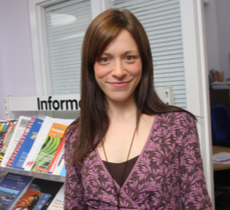
When can I take my benefits?
Normal Pension Age in the CUACPS is 65. However, it may be possible to take your benefits before or after age 65.
Late retirement
You can choose to take your benefits after age 65 and continue to pay into CUACPS to build up further benefits. If you do, your retirement pension and lump sum will include the extra blocks built up after age 65 as well as those built up before age 65.
see late retirement factsheet
Early retirement
If you take your benefits before age 65 (excluding retirement due to ill health) any pension you receive will be reduced because the pension will be paid for a longer period of time. Currently, the early retirement reduction is approximately 5% for each year you take your benefits before age 65.
Members who joined CUACPS before December 2009
For members who joined CUACPS before December 2009 there are some special provisions. These members can take their benefits from age 60 without any reduction in the final salary benefits they earned before 2013. In addition, their CRB benefits earned from 1 January 2013 will be reduced by approximately 5% for each year you take your benefits before age 63.
see early retirement factsheet

Slide 11
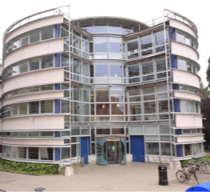
What happens if I die?
Death in service
If you joined CUACPS before December 2009, a lump sum of four times your salary is payable free of tax. In addition, if you are married or have a civil partner, your spouse or partner is entitled to receive a pension of 75% of the pension you would have received at age 65. A child allowance may also be payable if you have dependent children.
If you joined CUACPS on or after 1 December 2009, a lump sum of three times your salary is payable free of tax. In addition, if you are married or have a civil partner, your spouse or partner is entitled to receive a pension of 50% of the pension you would have received at age 65. A child allowance may also be payable if you have dependent children.
complete death benefits form
see death benefits factsheet
Death after retirement
If you joined CUACPS before December 2009, a pension of 75% of your pension at death will be paid to your spouse or partner. A, funeral grant will also be payable.
If you joined CUACPS on or after 1 December 2009, a pension of 50% of your pension at death will be paid to your spouse or partner. A funeral grant will also be payable.
The net funeral grant after HMRC charges ranges from £1,125 to £2,500.
see death benefits factsheet
Please note that the death benefits described on this page only relate to service in the CUACPS from 1 January 2013. Death in service and death after retirement pensions in relation to your final salary service up to 31 December 2012 will be paid in addition.

Slide 12
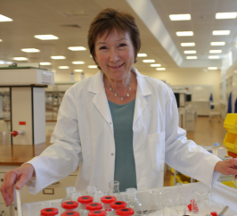
Salary sacrifice
SALARY SACRIFICE
The University and some other employers operate a salary sacrifice arrangement which is outlined in your contract of employment. Unless you asked not to join it, you will take part in this arrangement, which means your salary is reduced but the University pays your contributions to CUACPS.
WHAT IS SALARY SACRIFICE?
Under the salary sacrifice scheme your salary is reduced by an amount equal to your contribution to the Scheme (i.e. 5%). Your employer then pays the contribution on your behalf. As a result, members can make savings on their National Insurance Contributions which in turn leads to an increase in take home pay.
The salary sacrifice scheme does not have any effect on the amount of your Scheme pension benefits. However, if you leave the Scheme with less than 2 years’ service you would not be able to take a refund of any contributions made through the salary sacrifice arrangement (see also page 13).
see salary sacrifice factsheet
National Insurance
Members who use the salary sacrifice scheme may make additional NI savings which reduces the net cost of the Scheme for those members.

Slide 13

What happens if I leave the Scheme?
If you leave the Scheme either because you have left employment or because you opt out of the Scheme you have a number of choices with respect to your benefits.
see leaving service factsheet
1. Deferred benefits
If you have completed at least two years’ service, you can leave your pension and lump sum in the Scheme where they will continue to increase in line with RPI up to a maximum of 5% each year. If the annual RPI increase is above 5%, the University may provide an additional increase but this is not guaranteed. If you rejoin within one year of leaving you can rejoin the CRB section of the CUACPS.
2. Transfer
You can transfer your benefits to another approved pension arrangement. If you are considering a transfer it is important that you take independent financial advice.
The following websites may be useful if you need independent advice:
unbiased.co.uk findanadviser.org
3. Refund of contributions
If you have less than two years’ service you may be able to obtain a refund of your contributions to the scheme.
Please note that you will not be entitled to a refund of contributions for any period during which you participated in your employer’s salary sacrifice arrangement.
see salary sacrifice factsheet

Slide 14
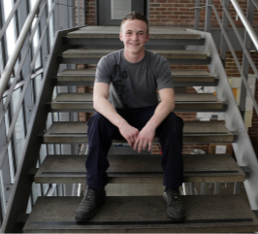
Auto enrolment
Employers must provide a pension arrangement for all eligible employees that meets the Government’s auto enrolment requirements.
What is auto enrolment?
Every employer in the UK must automatically enrol the vast majority of their employees into a suitable pension arrangement. For a pension arrangement to meet the Government’s auto enrolment requirements a number of criteria must be met including employer and employee contribution levels, regulation of the scheme and how benefits accrue to members.
There is also an obligation, on a set date every three years, for employers to assess employees who have previously opted out of the scheme and re-enrol these employees if certain criteria are met.
The CUACPS meets or exceeds these requirements and is therefore a “qualifying” scheme. As a member of CUACPS you don’t need to do anything about auto enrolment.

Slide 15
Important information and contacts
Scheme documents
Copies of Scheme reports, the Scheme Rules and other documents are available on the University’s pensions website at: pensions.admin.cam.ac.uk/cps
Scheme queries
If you have any questions relating to your benefits you can contact the Pensions Section using the email address below:
pensionsonline@admin.cam.ac.uk
Scheme complaints
We have a formal procedure for dealing with member disputes and complaints which can be accessed using the following link:
pensions.admin.cam.ac.uk/cps
In the first instance, if you have a problem or complaint relating to the Scheme, please write to the Head of Pensions Administration
at the address given on page 2 of this guide.
Scheme Rules
This guide provides a summary of your benefits. However, your legal rights are governed by the Trust Deed and Rules of CUACPS. If there are any differences between the Scheme Rules and this guide, the Rules will override the guide. A copy of the rules can be found using the following link:
pensions.admin.cam.ac.uk/cps

Slide 16
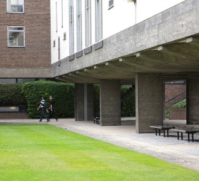
Important information and contacts
The Pensions Regulator
Is the regulatory body responsible for enforcing the law on occupational pension schemes such as CPS. Its address is:
The Pensions Regulator
Telecom House
125-135 Preston Road
Brighton BN1 6AF
Tel: 0845 600 0707
thepensionsregulator.gov.uk
The Pensions Ombudsman
May investigate any complaints or disputes of fact or law with respect to an occupational pension scheme. Its address is:
The Pensions Ombudsman
10 Colonade south
Canary Wharf
London
E14 4PU
Tel: 0207 630 2200
pensions-ombudsman.org.uk
MoneyHelper
May assist members and beneficiaries with any unresolved pension queries. Their address is:
MoneyHelper
120 Holborn,
London
EC1N 2TD
moneyhelper.org.uk
Pension Tracing Service
Helps people trace details of pension schemes they may have lost contact with. Their address is:
Pension Service 9
Mail Handling Site A
Wolverhampton WV98 1LU
Tel: 0345 6002537
or you can use the online service at
www.gov.uk/find-pension-contact -details

Slide 17
List of detailed factsheets available from the Pensions Office or website
1. Eligibility
2. Retirement benefits
3. Contributions
4. Salary sacrifice
5. Additional Voluntary Contributions
6. Early retirement
7. Late retirement
8. Pension increases
9. Death benefits
10. Leaving service benefits
11. Ill health benefits
12. Transfers
13. Divorce
14. State benefits
15. Disputes and complaints
16. Flexible Retirement
17. Absence

